Slide 1
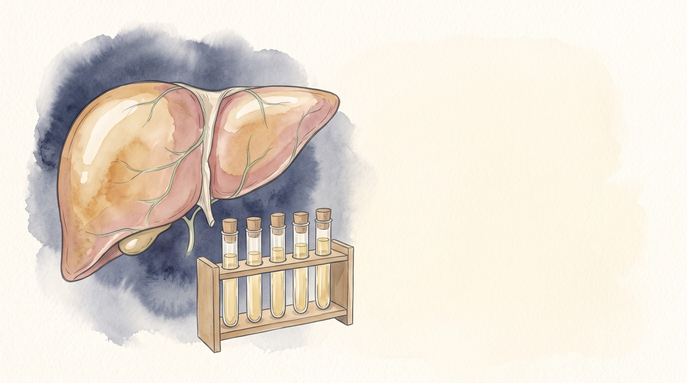


Chronic Hepatitis B
Mohammad Almeqdadi, MD
Transplant Hepatologist and Gastroenterologist
Assistant Professor of Medicine and Surgery
X: @mfalmeqdadi
Slides (PDF)
Illustrations generated with Google Gemini
Notes:
Everything in the cases is made up for teaching; none of it is a real patient. Three patients carry the talk: a man we follow from age 34 to 57, a woman about to start rituximab, and a pregnant woman.

Slide 2
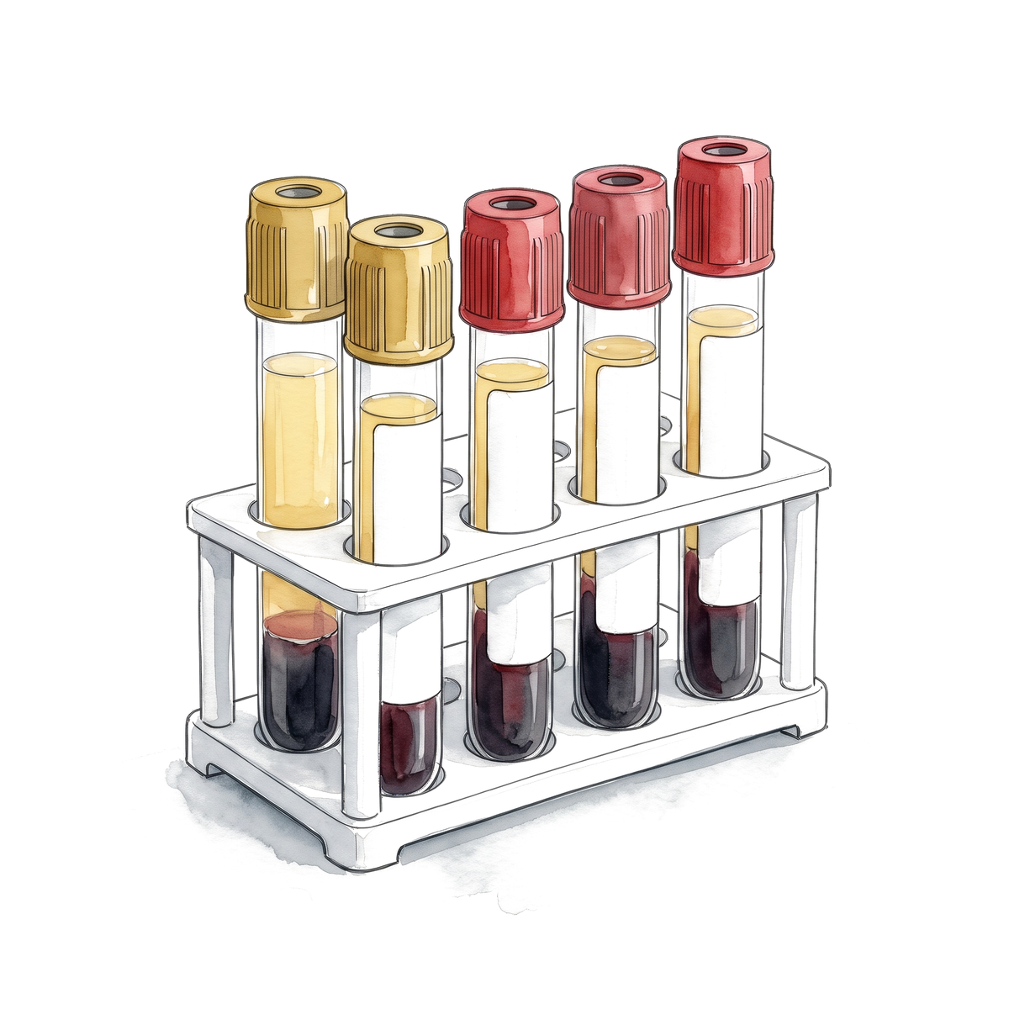
Objectives
By the end of this talk you should be able to:
Read a hepatitis B serology panel
Place a patient in the right phase
Decide who to treat, using the current guidelines
Estimate HCC risk and set up surveillance
Prevent reactivation and transmission to the baby
2/57
Notes:
Several of the recommendations changed in the last two years: AASLD/IDSA 2025, EASL 2025, WHO 2024. Where the guidelines disagree I show them side by side.

Slide 3
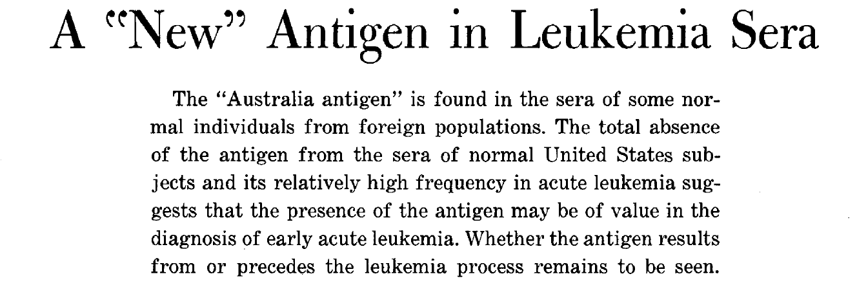
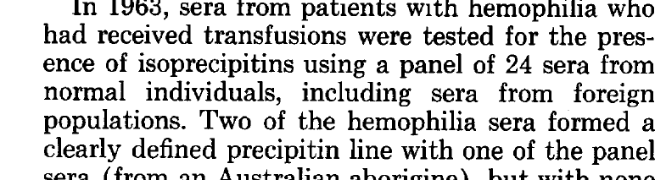
The Australia antigen
Found in the serum of some normal people from foreign populations, and in none of the normal US subjects
Frequent in acute leukemia, which is why the paper is about leukemia
Blumberg shared the 1976 Nobel Prize with Carleton Gajdusek
Blumberg BS, Alter HJ, Visnich S. JAMA 1965;191:541-546. PMID 14239025.
3/57
Notes:
Tell the story the way you like to. In 1963 the Philadelphia group tested sera from transfused hemophilia patients against a panel of 24 normal sera, including sera from foreign populations. Two hemophilia sera made a precipitin line with one panel serum, from an Australian aborigine. That is where the name comes from. The 1965 paper was about leukemia; the link to hepatitis came later. The Nobel citation reads: 'for their discoveries concerning new mechanisms for the origin and dissemination of infectious diseases' (NIH Nobel page). Source for the slide text is the paper itself (your PDF).

Slide 4
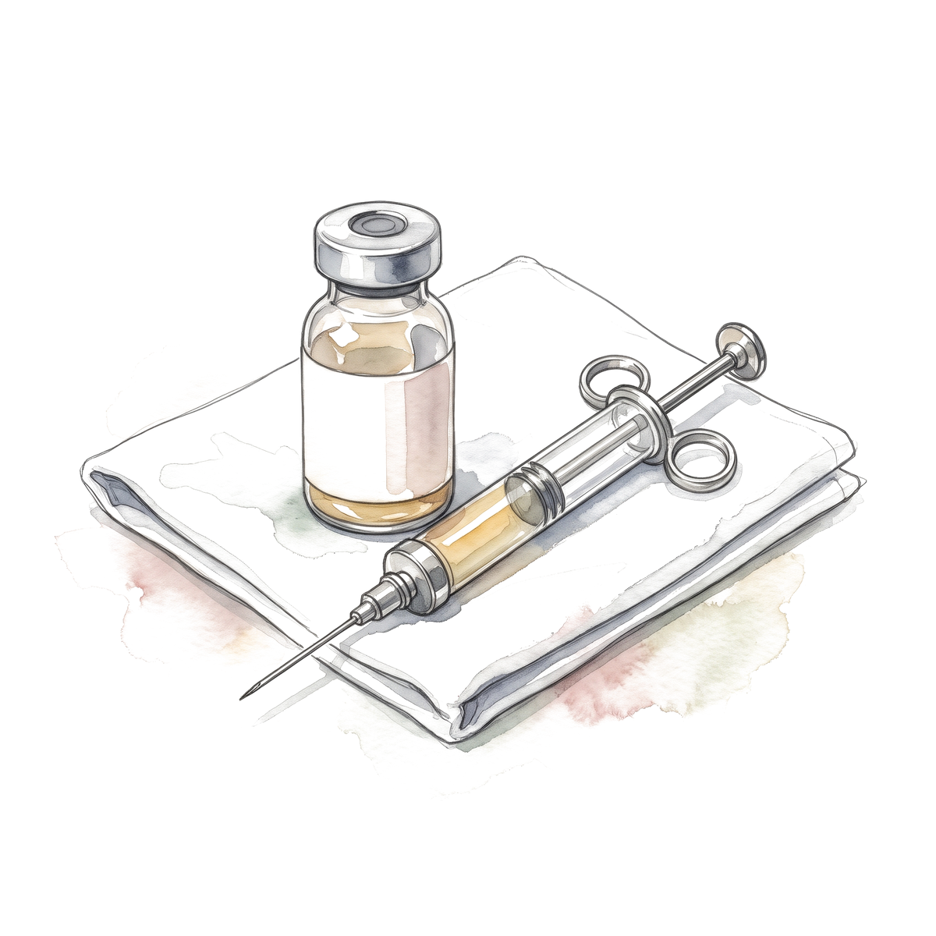
From antigen to vaccine
1965
1970
1976
1980
1981
Blumberg, Alter and Visnich describe the Australia antigen
Dane, Cameron and Briggs see the virus particle in serum
Blumberg and Gajdusek receive the Nobel Prize. First immunization of people with plasma-derived vaccine (Maupas)
Szmuness: the vaccine works in a controlled trial of 1,083 men
Beasley: HBsAg carriers in Taiwan get liver cancer at a far higher rate
PMIDs: Dane 4190997; Maupas 59012; Szmuness 6997738; Beasley 6118576.
4/57
Notes:
Keep it short in the 30-minute version. Dane 1970 Lancet 1:695-698. Maupas 1976 Lancet 1:1367-1370. Szmuness 1980 NEJM 303:833-841. Beasley 1981 Lancet 2:1129-1133. The vaccine came before there was a screening test for liver cancer. A recombinant yeast vaccine was reported in 1984 (McAleer, Nature 307:178-180).

Slide 5
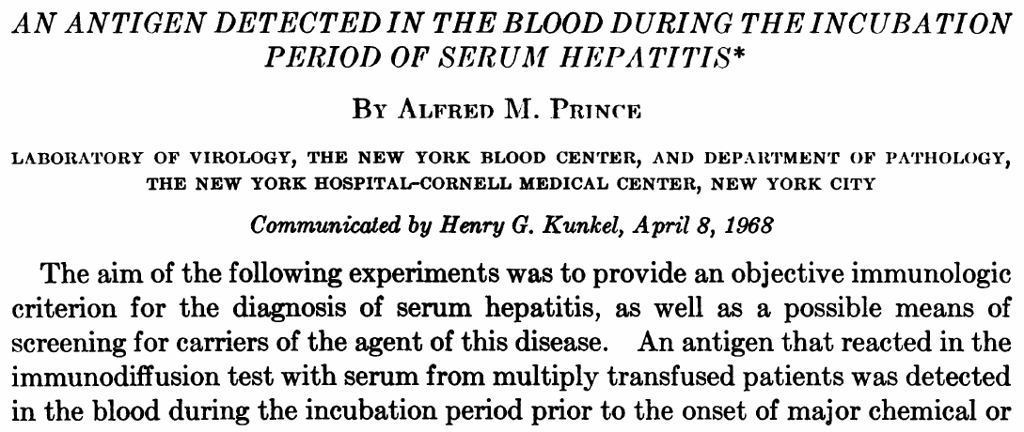
Prince, 1968
Okochi and Murakami reported the antigen in Japanese the same year
Prince AM. PNAS 1968;60:814-821, PMID 4970112. Okochi K, Murakami S. Vox Sang 1968;15:374-385, PMID 5749015.
5/57
Notes:
Prince detected the antigen in blood during the incubation period of serum hepatitis, which tied it to post-transfusion hepatitis and made screening of blood possible.

Slide 6
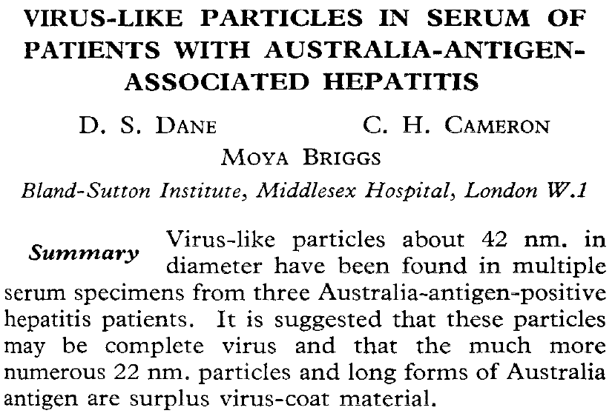
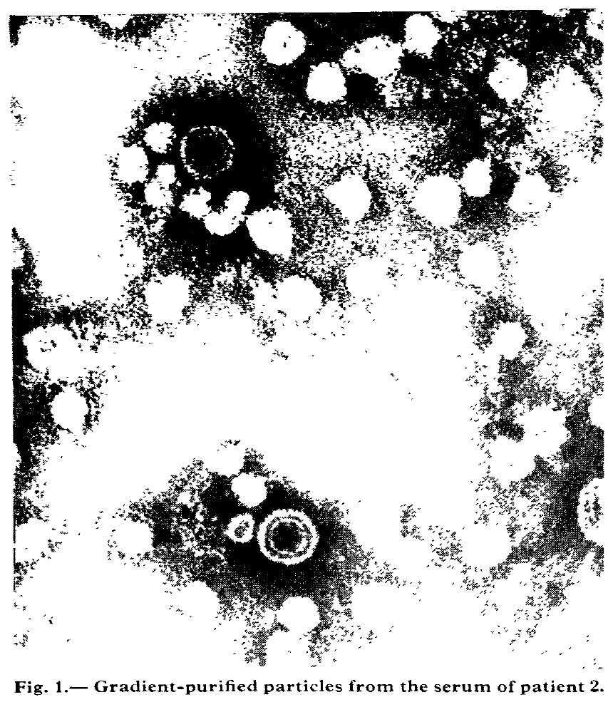
Dane, 1970
Dane DS, Cameron CH, Briggs M. Lancet 1970;1:695-698. PMID 4190997.
6/57
Notes:
The 42 nm particle is the whole virion; the numerous 22 nm particles and long forms are surface antigen only. This is why HBsAg circulates in huge excess over virions. The figure is from the paper in your PDF.

Slide 7
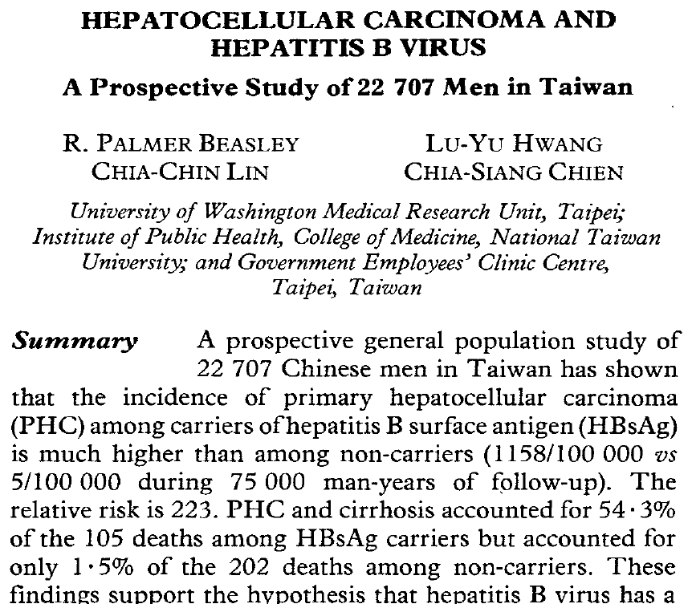
Beasley, Taiwan, 1981
 | HBsAg carriers | Non-carriers
HCC incidence per 100,000 | 1,158 | 5
Deaths from HCC or cirrhosis | 54.3% of 105 | 1.5% of 202
Relative risk 223
Beasley RP et al. Lancet 1981;2:1129-1133. PMID 6118576.
7/57
Notes:
22,707 Chinese men, civil servants in Taiwan, followed prospectively. All numbers are from the paper's summary (your PDF). The 95% CI of 28 to 1,479 for the relative risk is quoted from a 2018 historical review (Koshiol, Cancer Epidemiol), not from the 1981 paper.

Slide 8
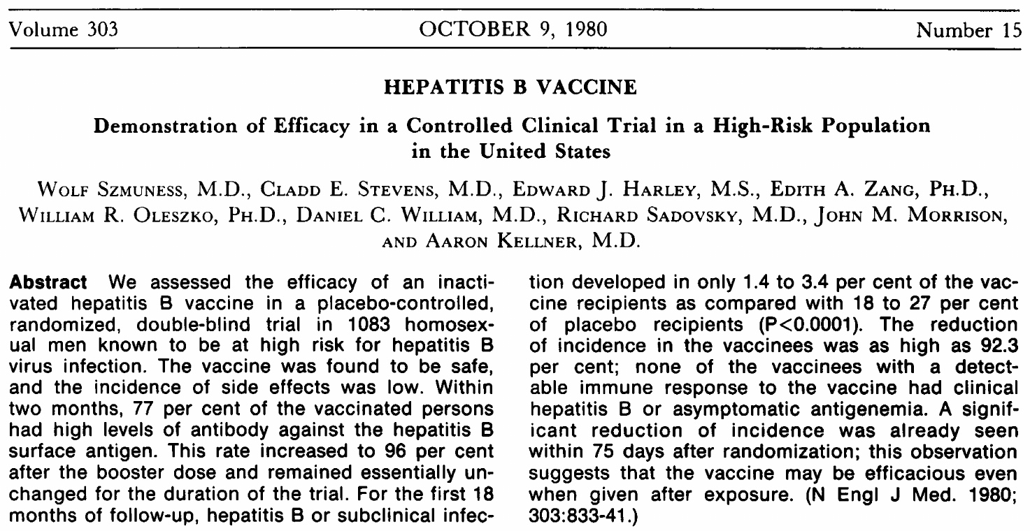
Szmuness, 1980
Szmuness W et al. N Engl J Med 1980;303:833-841. PMID 6997738.
8/57
Notes:
Randomized, double-blind, placebo-controlled, 1,083 men at high risk. Infection in only 1.4 to 3.4% of vaccinees versus 18 to 27% with placebo. The plasma-derived vaccine of Maupas (Lancet 1976) was the first human immunization; a recombinant yeast vaccine followed (McAleer, Nature 1984). Licensure in 1986 was not confirmed from a primary record, so say 'mid-1980s'.

Slide 9
Hepatitis B worldwide
How many people with chronic hepatitis B know it?
100%
Living with chronic hepatitis B (254 million)
Diagnosed
Treated (about 7 million)
WHO news release 9 April 2024 (2022 estimates), rounded. WHO Global hepatitis report 2024.
9/57
Notes:
Let them guess. Answer: about 13% diagnosed and about 3% treated. WHO 2022 estimates: 254 million living with chronic HBV, 1.2 million new infections a year, 1.3 million deaths from HBV and HCV combined, 83% of them HBV. The rounded WHO release is the source; the full report PDF was not opened. In the US, CDC estimates 580,000 to 2.4 million people living with chronic HBV, about two-thirds unaware (CDC 2023, PMID 36893044).

Slide 10
Hepatitis B worldwide
How many people with chronic hepatitis B know it?
100%
13%
3%
Living with chronic hepatitis B (254 million)
Diagnosed
Treated (about 7 million)
WHO news release 9 April 2024 (2022 estimates), rounded. WHO Global hepatitis report 2024.
9/57
Notes:
Let them guess. Answer: about 13% diagnosed and about 3% treated. WHO 2022 estimates: 254 million living with chronic HBV, 1.2 million new infections a year, 1.3 million deaths from HBV and HCV combined, 83% of them HBV. The rounded WHO release is the source; the full report PDF was not opened. In the US, CDC estimates 580,000 to 2.4 million people living with chronic HBV, about two-thirds unaware (CDC 2023, PMID 36893044).

Slide 11
Who becomes chronic?
How often does infection become chronic, by age at infection?
Infected at birth
Infected at age 1 to 4
Infected as an adult
WHO guidelines for chronic hepatitis B, 2024. CDC perinatal hepatitis B overview, 2025.
10/57
Notes:
Conditional risk once infected, not the risk that an exposed infant becomes infected. The bar for adults is drawn at 5% for scale; the figure is 'under 5%'.

Slide 12
Who becomes chronic?
How often does infection become chronic, by age at infection?
About 90%
About 30%
Under 5%
Infected at birth
Infected at age 1 to 4
Infected as an adult
WHO guidelines for chronic hepatitis B, 2024. CDC perinatal hepatitis B overview, 2025.
10/57
Notes:
Conditional risk once infected, not the risk that an exposed infant becomes infected. The bar for adults is drawn at 5% for scale; the figure is 'under 5%'.

Slide 13
Hepatitis B in the United States
Estimate | People with chronic HBV | Source
NHANES 2013 to 2018 | 880,000 (580,000 to 1.17 million) | Household survey
Meta-analysis including immigrants | 1.89 million (1.49 to 2.4 million) | 1.47 million are foreign-born
Not aware of the infection | About two-thirds | CDC 2023
Born outside the US | About 69% | CDC 2023
Conners EE et al. MMWR Recomm Rep 2023;72(1):1-25. PMID 36893044.
11/57
Notes:
The two estimates differ because the survey misses many immigrants. Do not combine one study's prevalence with another study's diagnosed share.

Slide 14
Screening an adult for hepatitis B
Which three tests make up the screening panel?
Question | Test
Is there a current infection?
Is the patient immune?
Has the patient ever been exposed?
CDC recommendations, MMWR Recomm Rep 2023;72(1):1-25, PMID 36893044.
12/57
Notes:
CDC 2023: screen every adult 18 and older at least once with the triple panel, regardless of disclosed risk, and screen in each pregnancy. HBsAg alone misses anti-HBc-only patients, who are the ones at risk of reactivation. Vaccination: all adults 19 to 59 (ACIP 2022); Heplisav-B, Engerix-B and Recombivax HB are in use. PreHevbrio was withdrawn in November 2024 because the company closed, not for safety.

Slide 15
Screening an adult for hepatitis B
Which three tests make up the screening panel?
Question | Test
Is there a current infection? | HBsAg
Is the patient immune? | Anti-HBs
Has the patient ever been exposed? | Total anti-HBc
Once for every adult 18 and older, and in every pregnancy
CDC recommendations, MMWR Recomm Rep 2023;72(1):1-25, PMID 36893044.
12/57
Notes:
CDC 2023: screen every adult 18 and older at least once with the triple panel, regardless of disclosed risk, and screen in each pregnancy. HBsAg alone misses anti-HBc-only patients, who are the ones at risk of reactivation. Vaccination: all adults 19 to 59 (ACIP 2022); Heplisav-B, Engerix-B and Recombivax HB are in use. PreHevbrio was withdrawn in November 2024 because the company closed, not for safety.

Slide 16
Five panels
What does each panel mean?
 | HBsAg | Total anti-HBc | IgM anti-HBc | Anti-HBs | Interpretation
Panel 1 | – | – | – | –
Panel 2 | – | – | – | +
Panel 3 | – | + | – | +
Panel 4 | + | + | – | –
Panel 5 | + | + | + | –
Interpretation per CDC 2023 (Table 1), MMWR Recomm Rep 2023;72(1):1-25.
13/57
Notes:
Chronic means HBsAg present for more than 6 months, so panel 4 needs a repeat. IgM anti-HBc also turns positive during a flare of chronic hepatitis B or a reactivation, so IgM plus a high ALT is not always acute infection: look at the history and the DNA. Resolved infection can reactivate under immunosuppression, which leads to the next slide.

Slide 17
Five panels
What does each panel mean?
 | HBsAg | Total anti-HBc | IgM anti-HBc | Anti-HBs | Interpretation
Panel 1 | – | – | – | – | Susceptible
Panel 2 | – | – | – | + | Vaccinated
Panel 3 | – | + | – | + | Resolved infection
Panel 4 | + | + | – | – | Chronic infection
Panel 5 | + | + | + | – | Acute infection
Interpretation per CDC 2023 (Table 1), MMWR Recomm Rep 2023;72(1):1-25.
13/57
Notes:
Chronic means HBsAg present for more than 6 months, so panel 4 needs a repeat. IgM anti-HBc also turns positive during a flare of chronic hepatitis B or a reactivation, so IgM plus a high ALT is not always acute infection: look at the history and the DNA. Resolved infection can reactivate under immunosuppression, which leads to the next slide.

Slide 18
61-year-old woman starting rituximab
HBsAg | Total anti-HBc | Anti-HBs | HBV DNA | ALT
– | + | – | Not done | 28 U/L
What could this be, and what do you order?
Possibility | How you sort it out
CDC 2023 (Table 1), PMID 36893044; AASLD 2018 hepatitis B guidance, PMID 29405329.
14/57
Notes:
Isolated anti-HBc is not the same as occult infection: occult needs detectable HBV DNA with a negative HBsAg. Order HBV DNA and repeat the panel. Whatever the answer, a patient who is anti-HBc positive and about to get an anti-CD20 drug needs prophylaxis (we come back to this). Wording of the last row, 'repeat testing', is my summary of the CDC table; check it.

Slide 19
61-year-old woman starting rituximab
HBsAg | Total anti-HBc | Anti-HBs | HBV DNA | ALT
– | + | – | Not done | 28 U/L
What could this be, and what do you order?
Possibility | How you sort it out
Resolved infection, anti-HBs has waned | HBV DNA undetectable
Occult infection | HBV DNA detectable
Window period | IgM anti-HBc positive
False-positive anti-HBc | Repeat testing, DNA undetectable
CDC 2023 (Table 1), PMID 36893044; AASLD 2018 hepatitis B guidance, PMID 29405329.
14/57
Notes:
Isolated anti-HBc is not the same as occult infection: occult needs detectable HBV DNA with a negative HBsAg. Order HBV DNA and repeat the panel. Whatever the answer, a patient who is anti-HBc positive and about to get an anti-CD20 drug needs prophylaxis (we come back to this). Wording of the last row, 'repeat testing', is my summary of the CDC table; check it.

Slide 20
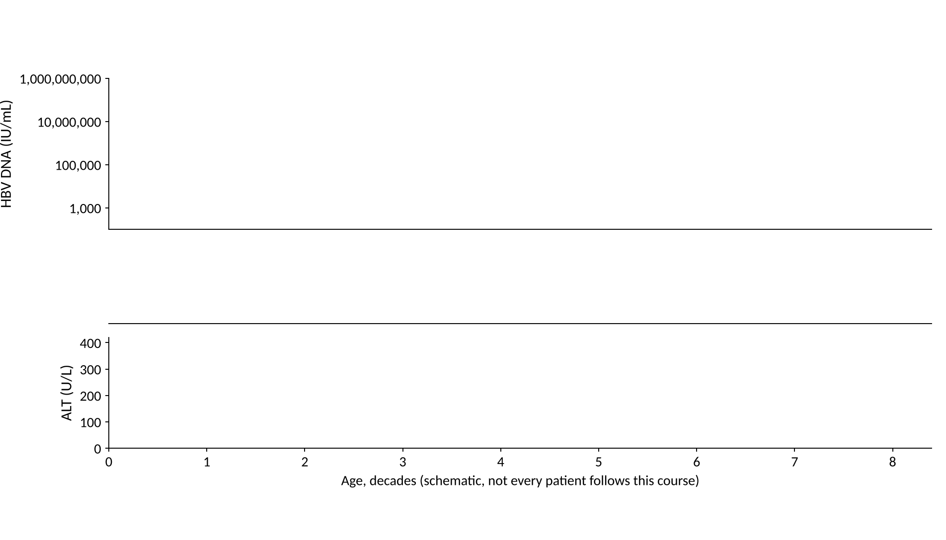
Natural history of chronic hepatitis B
Where do HBV DNA, ALT and the antigens go over a lifetime?
15/57
Notes:
Draw it with the room: three panels, age in decades along the bottom. This is the figure from your sketch. Schematic, not data.

Slide 21
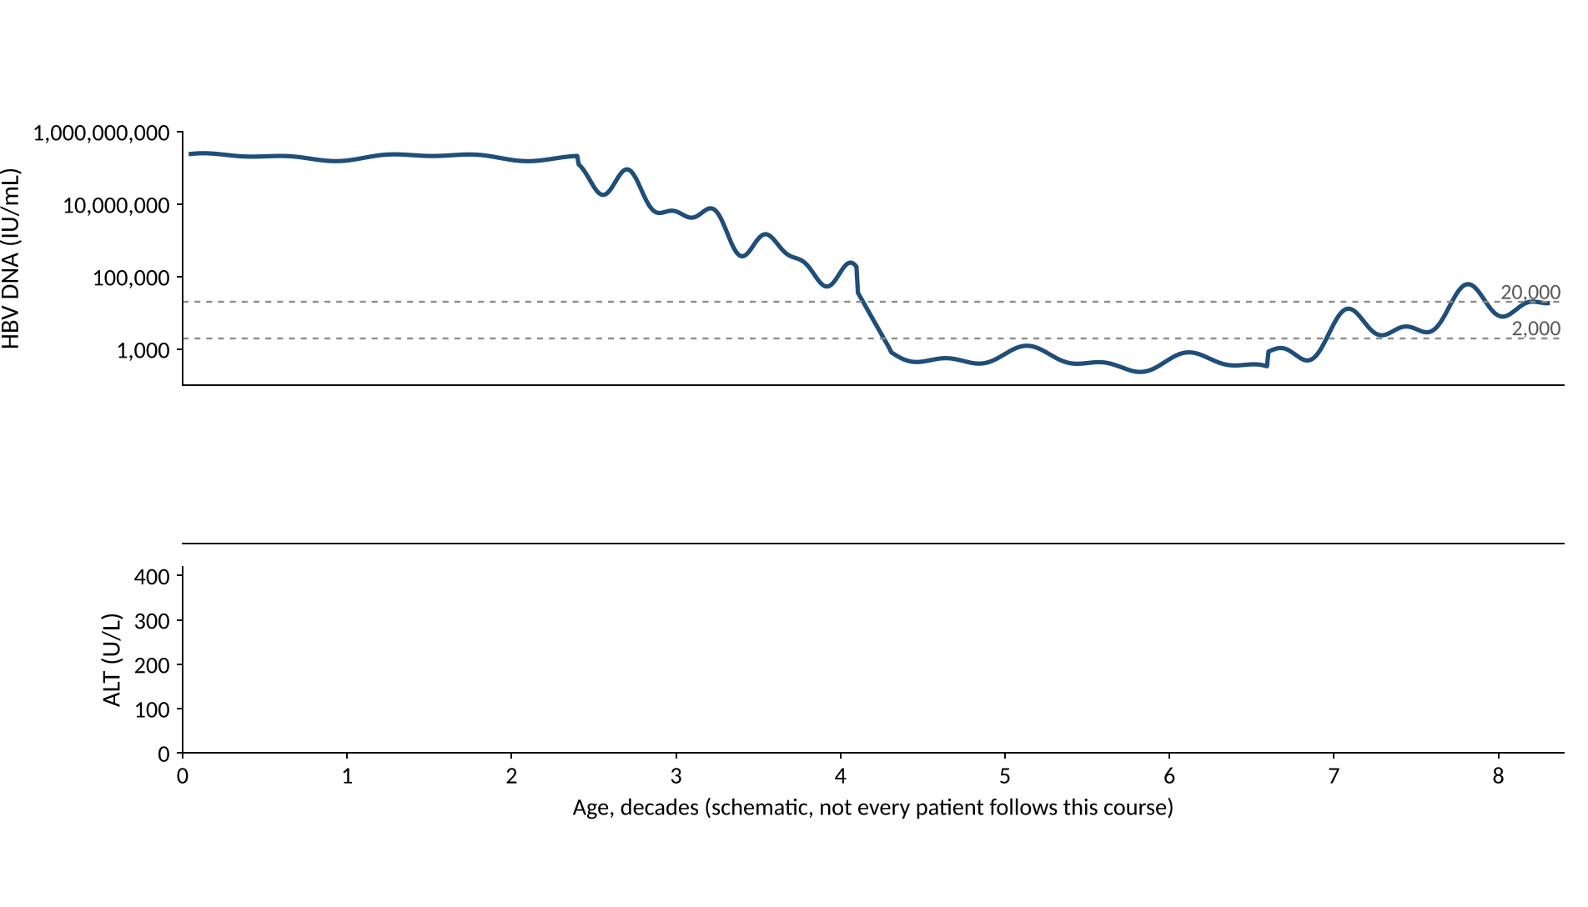
Natural history of chronic hepatitis B
15/57
Notes:
HBV DNA first. Very high in early life, falls in the third and fourth decades, then either stays low or rises again. The dashed lines are 20,000 and 2,000 IU/mL.

Slide 22
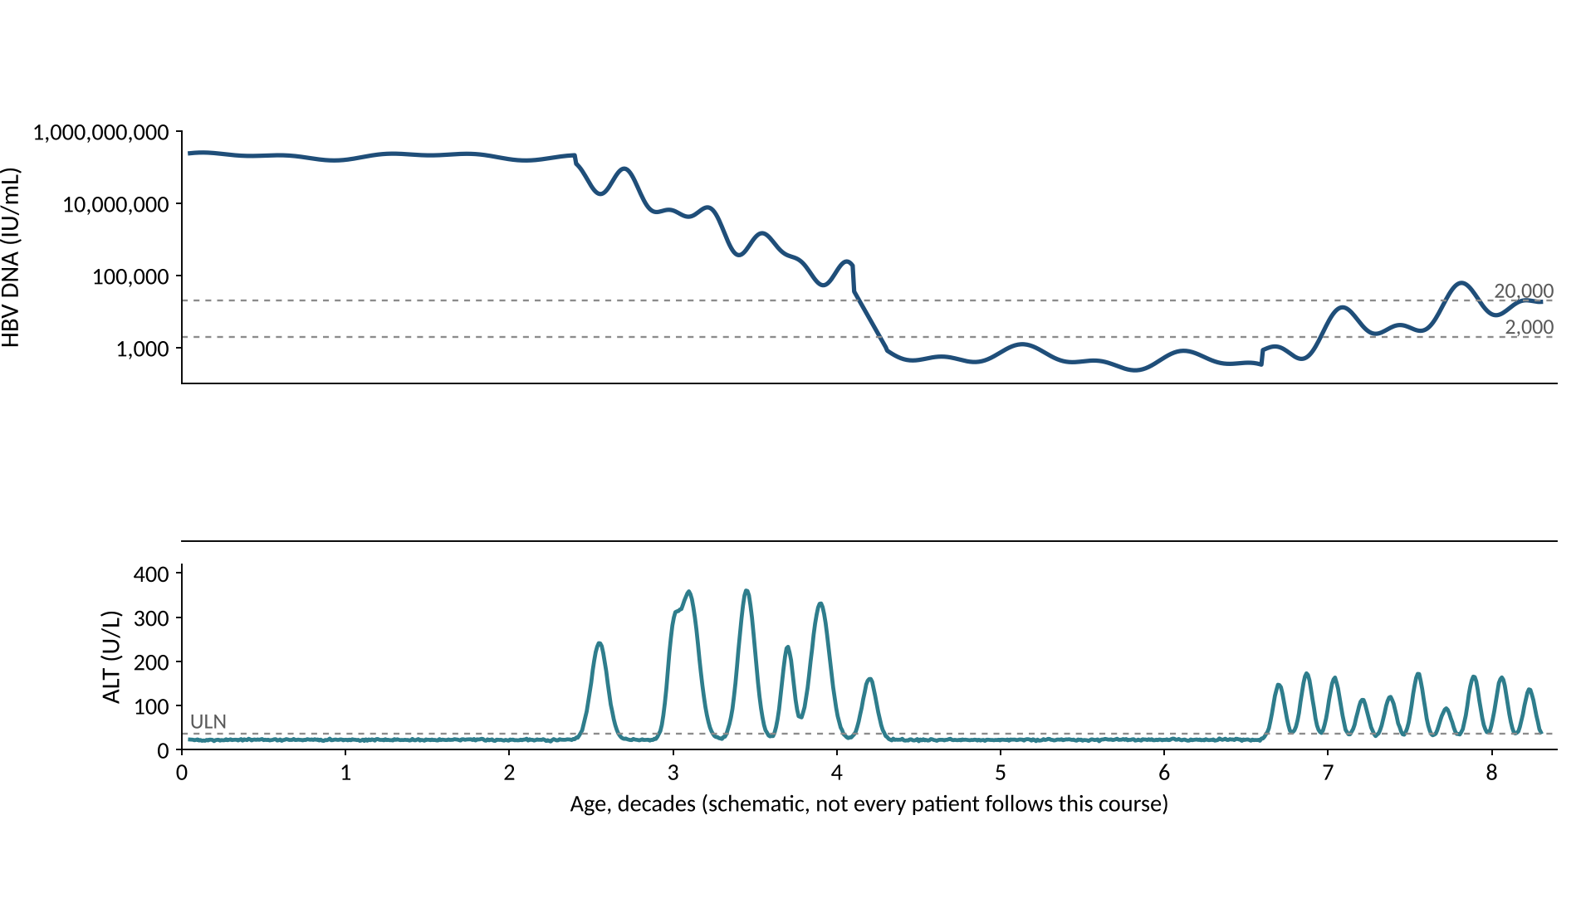
Natural history of chronic hepatitis B
15/57
Notes:
Now ALT. Normal for decades, then flares when the immune system finally attacks. Each flare can cause fibrosis.

Slide 23
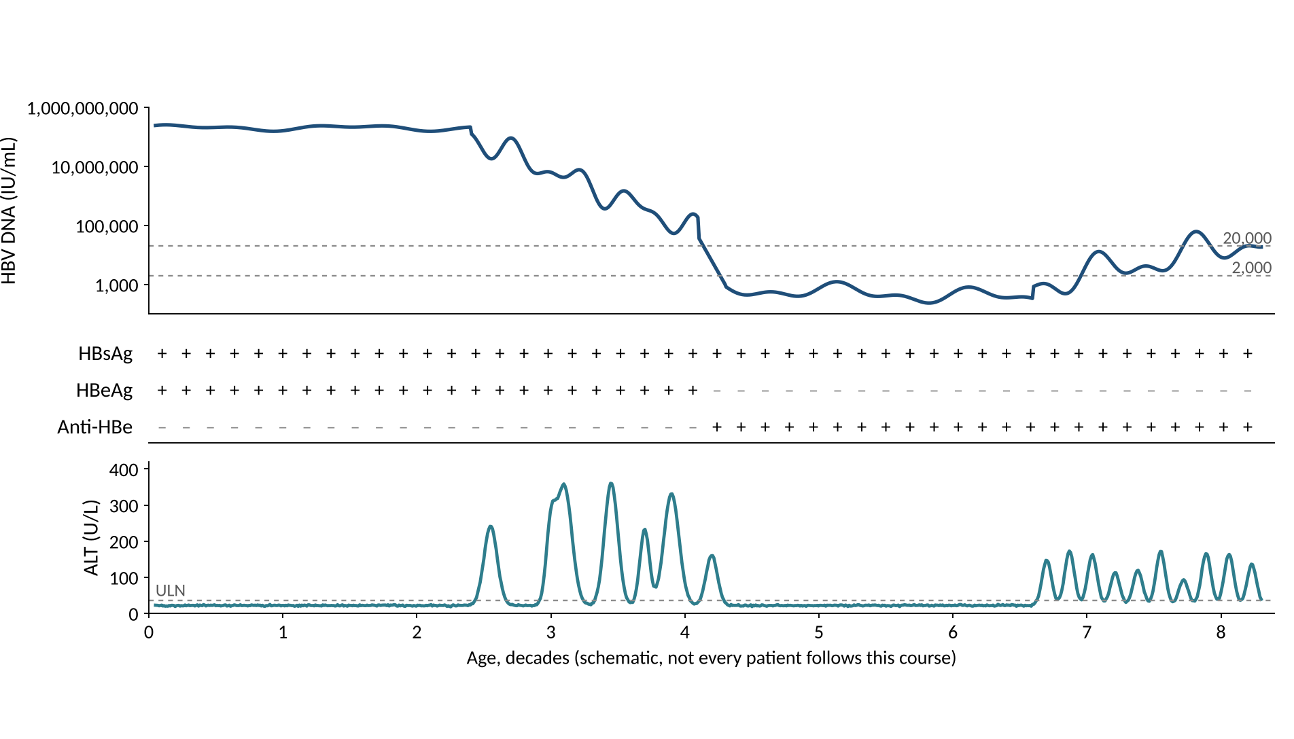
Natural history of chronic hepatitis B
15/57
Notes:
The antigens. HBsAg stays positive. HBeAg is lost and anti-HBe appears when the patient seroconverts, around the fourth decade in this schematic.

Slide 24
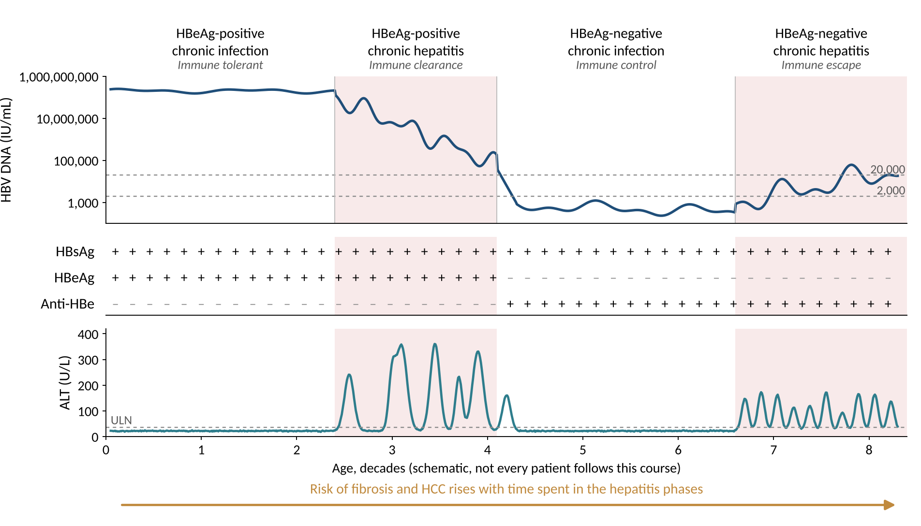
Natural history of chronic hepatitis B
15/57
Notes:
Now name the phases. New names above, old names below. The shaded phases are the hepatitis phases. Not every patient goes through all four, and the age axis is schematic.

Slide 25
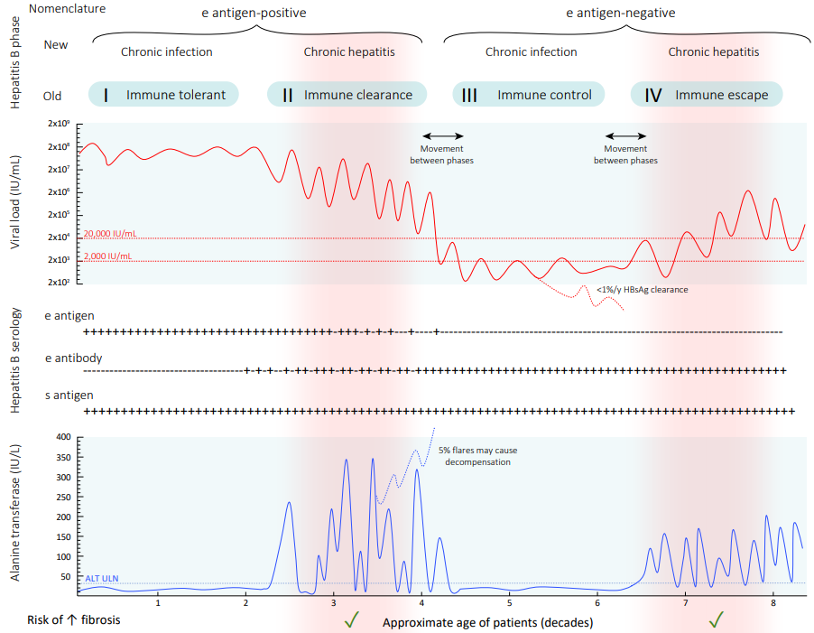
The published version
GESA Australian consensus recommendations for the management of hepatitis B infection, 2022, Figure 3.1 (as shown in the ASHM B Positive chapter).
16/57
Notes:
The same four phases in the published form. Credit GESA 2022 (ASHM attributes Figure 3.1 to them). The reviewer could not confirm the original artist or the reuse licence, so check before putting this in anything you distribute.

Slide 26
Match the labs to the phase
HBeAg | HBV DNA (IU/mL) | ALT | Phase
Positive | 10,000,000 or more | Normal
Positive | 10,000 to 10,000,000 | Raised
Negative | Below 2,000 | Normal
Negative | Above 2,000 | Raised
EASL Clinical Practice Guidelines on hepatitis B 2025, Table 4. J Hepatol 2025;83:502-583, PMID 40348683. Values are 'usually'.
17/57
Notes:
Old names: immune tolerant, immune clearance (immune-active), inactive carrier or immune control, immune escape. AASLD 2018 uses immune-tolerant, HBeAg-positive immune-active, inactive and HBeAg-negative immune-active CHB. These are descriptions of phases, not treatment criteria. A patient can move between phases, and HBsAg loss is a fifth state (HBsAg-negative phase).

Slide 27
Match the labs to the phase
HBeAg | HBV DNA (IU/mL) | ALT | Phase
Positive | 10,000,000 or more | Normal | HBeAg-positive chronic infection
Positive | 10,000 to 10,000,000 | Raised | HBeAg-positive chronic hepatitis
Negative | Below 2,000 | Normal | HBeAg-negative chronic infection
Negative | Above 2,000 | Raised | HBeAg-negative chronic hepatitis
EASL Clinical Practice Guidelines on hepatitis B 2025, Table 4. J Hepatol 2025;83:502-583, PMID 40348683. Values are 'usually'.
17/57
Notes:
Old names: immune tolerant, immune clearance (immune-active), inactive carrier or immune control, immune escape. AASLD 2018 uses immune-tolerant, HBeAg-positive immune-active, inactive and HBeAg-negative immune-active CHB. These are descriptions of phases, not treatment criteria. A patient can move between phases, and HBsAg loss is a fifth state (HBsAg-negative phase).

Slide 28
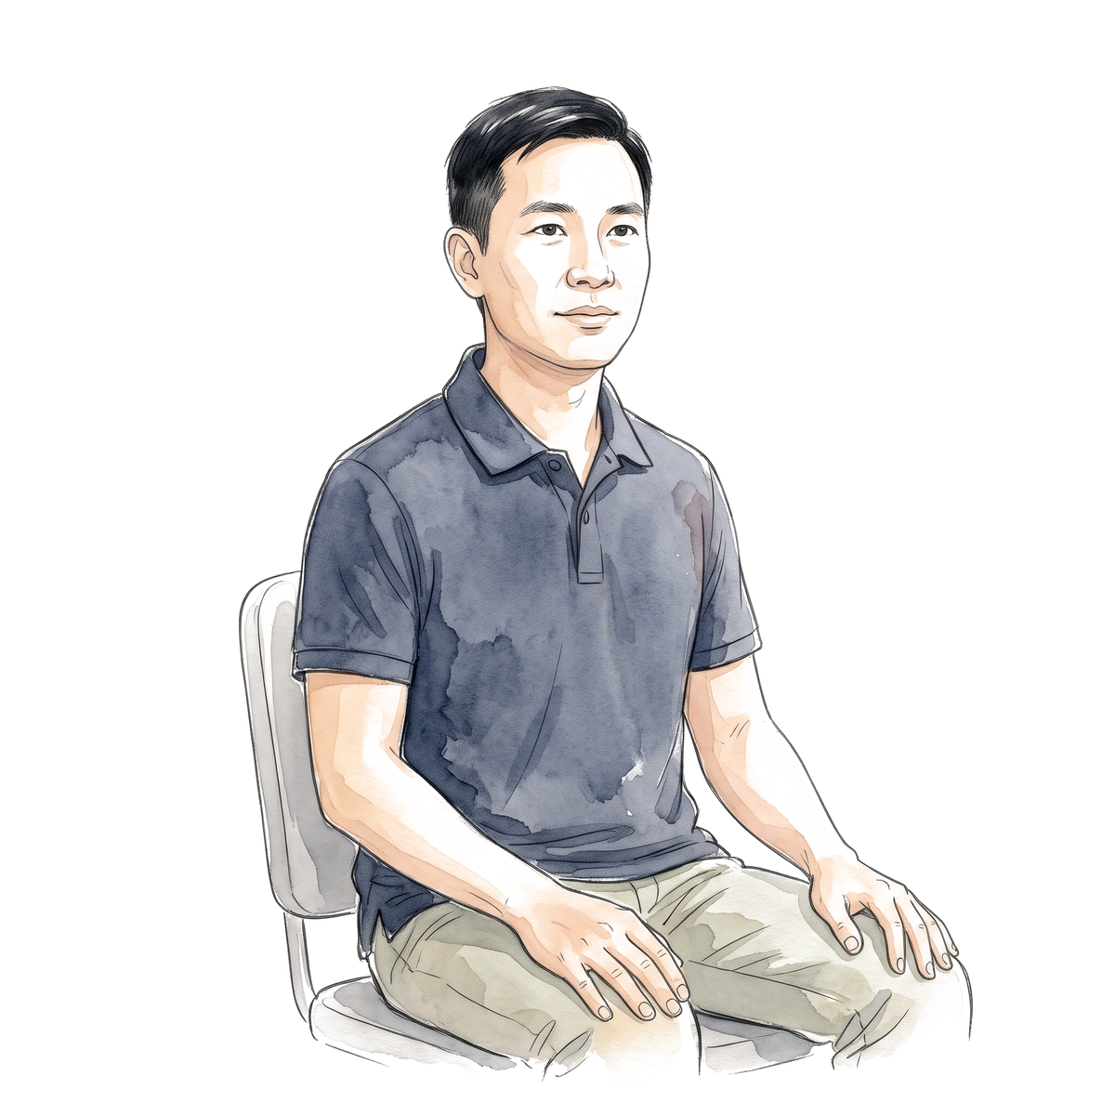
34-year-old man, born in Vietnam
Test | Result
HBsAg | Positive
HBeAg | Positive
Anti-HBe | Negative
HBV DNA | 60,000,000 IU/mL
ALT (ULN 35) | 24 U/L
Platelets | 245 x 10^9/L
Liver stiffness | 5.1 kPa
Do you treat him?
18/57
Notes:
HBsAg found at a blood donation, asymptomatic, ALT normal on two checks six months apart. This is the HBeAg-positive chronic infection (immune tolerant) phase. AASLD/IDSA 2025 R3 defines it as HBeAg positive, DNA above 10,000,000 IU/mL and persistently normal ALT on at least two measurements 6 months apart. At 34, no fibrosis, the recommendation is to monitor. AASLD 2018 R2A: against antiviral therapy in immune-tolerant adults. Stiffness 5.1 kPa is below the EASL F2 cut-off of 7 kPa. All values are made up.

Slide 29
34-year-old man, born in Vietnam
Test | Result
HBsAg | Positive
HBeAg | Positive
Anti-HBe | Negative
HBV DNA | 60,000,000 IU/mL
ALT (ULN 35) | 24 U/L
Platelets | 245 x 10^9/L
Liver stiffness | 5.1 kPa
Do you treat him?
No. Monitor ALT and DNA every 3 to 6 months
18/57
Notes:
HBsAg found at a blood donation, asymptomatic, ALT normal on two checks six months apart. This is the HBeAg-positive chronic infection (immune tolerant) phase. AASLD/IDSA 2025 R3 defines it as HBeAg positive, DNA above 10,000,000 IU/mL and persistently normal ALT on at least two measurements 6 months apart. At 34, no fibrosis, the recommendation is to monitor. AASLD 2018 R2A: against antiviral therapy in immune-tolerant adults. Stiffness 5.1 kPa is below the EASL F2 cut-off of 7 kPa. All values are made up.

Slide 30
Same man, now 41 years old
Test | Result
HBsAg | Positive
HBeAg | Positive
Anti-HBe | Negative
HBV DNA | 55,000,000 IU/mL
ALT (ULN 35) | 26 U/L
Platelets | 245 x 10^9/L
Liver stiffness | 5.1 kPa
Does the answer change?
19/57
Notes:
AASLD/IDSA 2025 R3 (conditional, very low certainty): for immune-tolerant adults, antiviral therapy is supported if over 40 or with grade 2 / stage 2 or worse disease. The recommendation text says 'over 40' and the guideline's algorithm says '40 or more'. The evidence is observational and the AASLD technical review calls it very uncertain, so this is a shared decision. EASL 2025 and WHO 2024 reach treatment through other pathways (fibrosis, family history of HCC); they do not use this age rule in the same way. The same labs at 34 and 41 make the point about age.

Slide 31
Same man, now 41 years old
Test | Result
HBsAg | Positive
HBeAg | Positive
Anti-HBe | Negative
HBV DNA | 55,000,000 IU/mL
ALT (ULN 35) | 26 U/L
Platelets | 245 x 10^9/L
Liver stiffness | 5.1 kPa
Does the answer change?
AASLD/IDSA 2025: over age 40 supports treatment
19/57
Notes:
AASLD/IDSA 2025 R3 (conditional, very low certainty): for immune-tolerant adults, antiviral therapy is supported if over 40 or with grade 2 / stage 2 or worse disease. The recommendation text says 'over 40' and the guideline's algorithm says '40 or more'. The evidence is observational and the AASLD technical review calls it very uncertain, so this is a shared decision. EASL 2025 and WHO 2024 reach treatment through other pathways (fibrosis, family history of HCC); they do not use this age rule in the same way. The same labs at 34 and 41 make the point about age.

Slide 32

Same man, now 52 years old
Test | Result
HBsAg | Positive
HBeAg | Negative
Anti-HBe | Positive
HBV DNA | 8,000 IU/mL
ALT | 48 U/L
Platelets | 190 x 10^9/L
FIB-4 | 1.8
Liver stiffness | 6.8 kPa
Do you treat him?
20/57
Notes:
He lost HBeAg and seroconverted in his late 40s. DNA 8,000, ALT 48 (1.4 times the AASLD upper limit of 35), no advanced fibrosis. Let the room commit. The next slide shows what each guideline says.

Slide 33
What counts as a normal ALT?
 | Men | Women
AASLD | 35 U/L | 25 U/L
WHO 2024 | 30 U/L | 19 U/L
EASL 2025 | 40 U/L | 40 U/L
His ALT of 48 U/L is above all three limits
Upper limits of normal as listed in the guidelines. AASLD 2018 PMID 29405329; WHO 2024; EASL 2025 PMID 40348683.
21/57
Notes:
The old reference ranges included people with fatty liver, which is why the blood-donor data gave lower limits (30 for men and 19 for women in the ASHM chapter). Whichever limit you use, 48 is raised. Next slide: what each guideline does with it.

Slide 34
Same labs, four guidelines
Treat or not?
 | AASLD 2018 | AASLD/IDSA 2025 | EASL 2025 | WHO 2024
52 y, HBeAg-negative, DNA 8,000, ALT 48
Compensated cirrhosis, DNA 500
Decompensated cirrhosis, any DNA
AASLD 2018 PMID 29405329; AASLD/IDSA 2025 Hepatology 2026;83:974-997 PMID 41186418; EASL 2025 PMID 40348683; WHO 2024 (NBK614987).
22/57
Notes:
Row 1: AASLD 2018 treats HBeAg-negative patients with DNA above 2,000 and ALT at least 2 times the upper limit (70 for a man) or significant histology, so he is observed. AASLD/IDSA 2025 R4 suggests treatment by shared decision in the indeterminate group. EASL 2025: DNA at least 2,000 with ALT above the upper limit or at least F2: treat. WHO 2024: DNA above 2,000 and ALT above the upper limit: treat. Rows 2 and 3 are the cirrhosis rows: AASLD 2018 R7A and R7B, AASLD/IDSA 2025 Figure 5, EASL (detectable DNA, any DNA if decompensated), WHO (treat regardless of DNA and ALT). The reviewer's dossier (section B1) has the full matrix. APASL 2026 criteria were not opened, so they are not shown.

Slide 35
Same labs, four guidelines
Treat or not?
 | AASLD 2018 | AASLD/IDSA 2025 | EASL 2025 | WHO 2024
52 y, HBeAg-negative, DNA 8,000, ALT 48 | Observe | Shared decision | Treat | Treat
Compensated cirrhosis, DNA 500 | Treat | Treat | Treat | Treat
Decompensated cirrhosis, any DNA | Treat | Treat | Treat | Treat
AASLD 2018 PMID 29405329; AASLD/IDSA 2025 Hepatology 2026;83:974-997 PMID 41186418; EASL 2025 PMID 40348683; WHO 2024 (NBK614987).
22/57
Notes:
Row 1: AASLD 2018 treats HBeAg-negative patients with DNA above 2,000 and ALT at least 2 times the upper limit (70 for a man) or significant histology, so he is observed. AASLD/IDSA 2025 R4 suggests treatment by shared decision in the indeterminate group. EASL 2025: DNA at least 2,000 with ALT above the upper limit or at least F2: treat. WHO 2024: DNA above 2,000 and ALT above the upper limit: treat. Rows 2 and 3 are the cirrhosis rows: AASLD 2018 R7A and R7B, AASLD/IDSA 2025 Figure 5, EASL (detectable DNA, any DNA if decompensated), WHO (treat regardless of DNA and ALT). The reviewer's dossier (section B1) has the full matrix. APASL 2026 criteria were not opened, so they are not shown.

Slide 36
Does treating this group help?
Study | Design | Patients | Outcome
Huang 2023 | Observational | 855, no advanced fibrosis | HCC, 5 to 15 years
TORCH-B 2021 | Randomized | 160, ALT 1 to 2 x ULN | Progression at 3 years
What do you expect?
Huang DQ et al. Hepatology 2023;78:1558-1568, PMID 37184202. Hsu YC et al. Lancet Infect Dis 2021;21:823-833, PMID 33524314.
23/57
Notes:
Huang: 855 patients in the indeterminate phase without advanced fibrosis; weighted analysis, adjusted HR for HCC 0.30 (0.10 to 0.60). Treated 3, 4 and 9% at 5, 10 and 15 years, untreated 3, 15 and 19%. Observational, so residual confounding remains. TORCH-B: 160 Taiwanese patients, TDF 300 mg for 3 years versus placebo, paired biopsies: progression of at least one Ishak stage 19/73 (26%) versus 34/73 (47%), RR 0.56 (0.35 to 0.88). Randomized, but small and not powered for HCC. ATTENTION (interim, Lancet Gastroenterol Hepatol 2025, 734 patients, TAF versus observation): primary composite events 2 versus 9, HR 0.21, 97.5% CI 0.04 to 1.20, did not cross its stopping boundary. None of these randomized treatment against HCC. Mention the counterweight (Jeon 2021: no HCC at 5 years in biomarker-defined immune tolerance with FIB-4 under 1.45).

Slide 37
Does treating this group help?
Study | Design | Patients | Outcome
Huang 2023 | Observational | 855, no advanced fibrosis | HCC, 5 to 15 years
TORCH-B 2021 | Randomized | 160, ALT 1 to 2 x ULN | Progression at 3 years
Cumulative HCC risk, %
Histologic progression, %
Huang DQ et al. Hepatology 2023;78:1558-1568, PMID 37184202. Hsu YC et al. Lancet Infect Dis 2021;21:823-833, PMID 33524314.
23/57
Notes:
Huang: 855 patients in the indeterminate phase without advanced fibrosis; weighted analysis, adjusted HR for HCC 0.30 (0.10 to 0.60). Treated 3, 4 and 9% at 5, 10 and 15 years, untreated 3, 15 and 19%. Observational, so residual confounding remains. TORCH-B: 160 Taiwanese patients, TDF 300 mg for 3 years versus placebo, paired biopsies: progression of at least one Ishak stage 19/73 (26%) versus 34/73 (47%), RR 0.56 (0.35 to 0.88). Randomized, but small and not powered for HCC. ATTENTION (interim, Lancet Gastroenterol Hepatol 2025, 734 patients, TAF versus observation): primary composite events 2 versus 9, HR 0.21, 97.5% CI 0.04 to 1.20, did not cross its stopping boundary. None of these randomized treatment against HCC. Mention the counterweight (Jeon 2021: no HCC at 5 years in biomarker-defined immune tolerance with FIB-4 under 1.45).

Slide 38
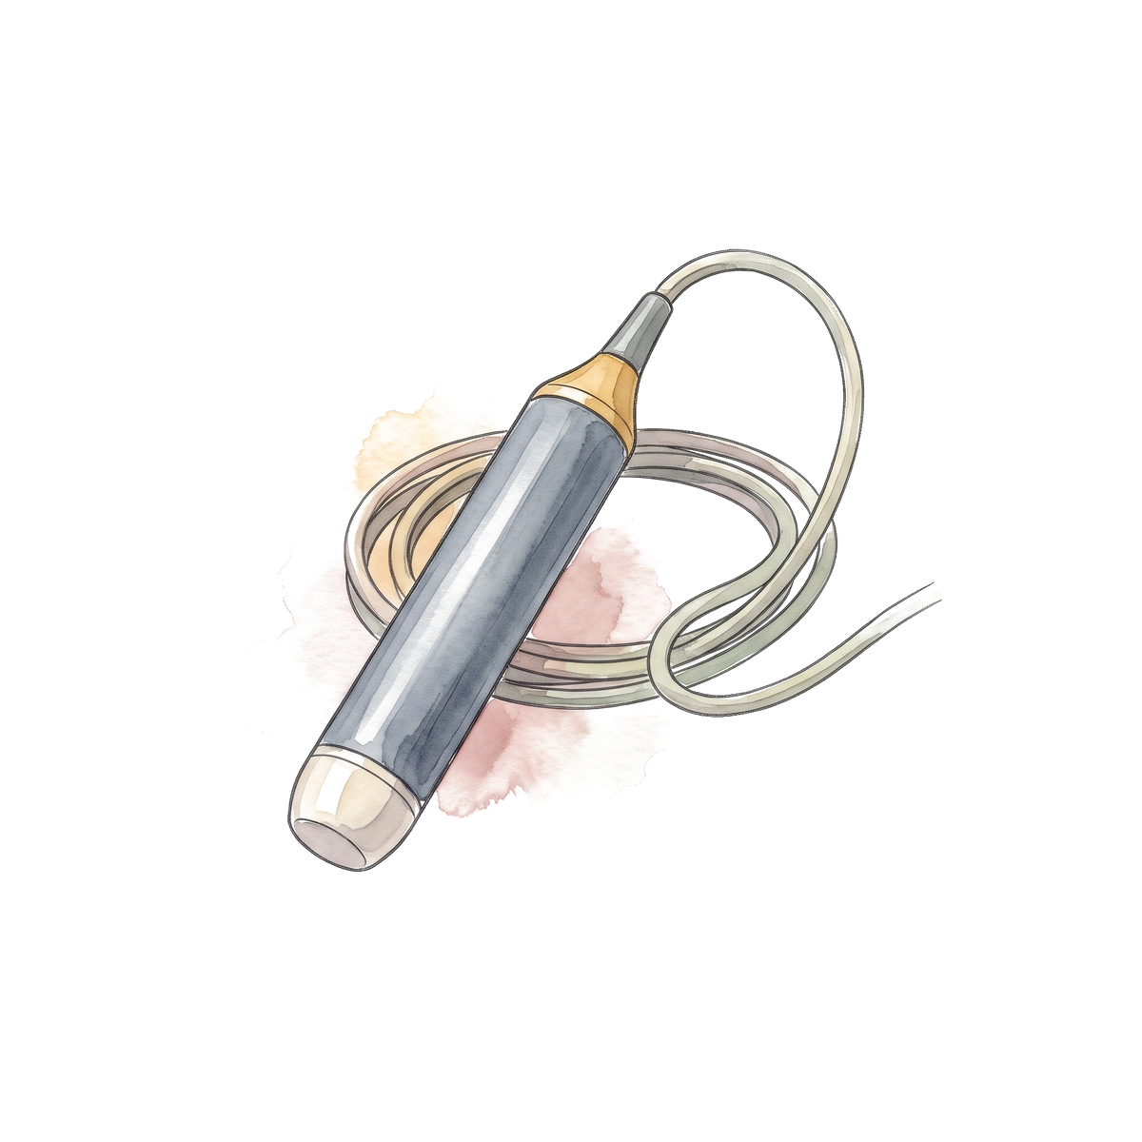
Fibrosis staging by elastography
 | EASL 2025 | WHO 2024
Significant fibrosis (F2) | Above 7 kPa | Above 7 kPa, or APRI above 0.5
Advanced fibrosis (F3) | Above 8 kPa
Cirrhosis (F4) | Above 11 kPa | APRI above 2 in the 2015 guideline
EASL 2025 PMID 40348683; WHO 2024 chapter 5.
24/57
Notes:
EASL 2025 Table 6 lists F2 above 7 kPa, F3 above 8 and F4 above 11. WHO 2024 uses APRI above 0.5 or elastography above 7 kPa as a treatment pathway, with no DNA threshold. Do not teach a single FibroScan cut-off of 8 for every purpose. The WHO cirrhosis row is from the 2015 guideline as described in the reviewer's dossier; check the 2024 text before using that row.

Slide 39
Treat everyone with high DNA and normal ALT?
 | Kim, Gut 2018 | Jeon, Clin Mol Hepatol 2021
Patients | 413 untreated immune-tolerant, 1,497 treated immune-active | Biomarker-defined immune tolerance, FIB-4 under 1.45 subgroup
Result | 10-year HCC 12.7% vs 6.1%; adjusted HR 2.54 (1.54 to 4.18) | HCC 0% at 1, 3 and 5 years vs 0.2, 0.6 and 1.4% in comparators
Limit | Different phases, selected treatment | Small low-risk sample
Kim GA et al. Gut 2018;67:945-952, PMID 29055908. Jeon MY et al. Clin Mol Hepatol 2021;27:295-304, PMID 33317247.
25/57
Notes:
Two studies that point in opposite directions. Kim: Korean retrospective cohort; death or transplant 9.7% vs 3.4% at 10 years, HR 3.38 (1.85 to 6.16). The untreated group used a broad definition (DNA at least 20,000), broader than strict immune tolerance. Jeon found essentially no HCC in carefully defined immune-tolerant patients with low FIB-4. The AASLD technical review grades the evidence for clinical benefit in immune tolerance as very uncertain. Nothing here proves that treating every young, strictly immune-tolerant patient lowers lifetime HCC risk.

Slide 40
The indeterminate phase
 | Result
Meta-analysis, 103 studies (Lai, J Hepatol 2025) | Significant fibrosis in 39.7%; HCC 0.32% a year; treatment IRR 0.38 (0.18 to 0.79)
ATTENTION interim, 734 patients (Lim, 2025) | Events 2 vs 9, HR 0.21, 97.5% CI 0.04 to 1.20; stopping boundary not crossed
Lai JC et al. J Hepatol 2025;82:992-1003, PMID 39577468. Lim YS et al. Lancet Gastroenterol Hepatol 2025;10:295-305, PMID 39914435.
26/57
Notes:
Lai 2025: heterogeneity was high (I2 85.7% for HCC) and the definitions of the grey zone varied. ATTENTION: TAF 369 vs observation 365, DNA 10,000 to 100,000,000 IU/mL, ALT below 70 for men and below 50 for women, noncirrhotic, ages 40 to 80, median follow-up 17.7 months. Promising, not definitive.

Slide 41
58-year-old man, eGFR 45
Which nucleos(t)ide analogue?
 | Dose | At eGFR 30 to 49
Entecavir | 0.5 mg daily | 0.5 mg every 48 hours
TDF | 300 mg daily | 300 mg every 48 hours
TAF | 25 mg daily with food | 25 mg daily
US prescribing information: Baraclude, Viread, Vemlidy (DailyMed). Renal doses use creatinine clearance.
27/57
Notes:
The renal rows are from the US labels. Entecavir: for CrCl 30 to 49, 0.25 mg daily or 0.5 mg every 48 hours; use the oral solution for the daily fractions. TDF: CrCl 30 to 49, 300 mg every 48 hours. TAF: no adjustment at CrCl 15 or above. TAF is not recommended in Child-Pugh B or C in the US label, and the old statement that TAF cannot be used on dialysis is out of date. The answer line is my teaching summary, based on the TAF versus TDF trial data on the next slide; confirm it is how you would say it.

Slide 42
58-year-old man, eGFR 45
Which nucleos(t)ide analogue?
 | Dose | At eGFR 30 to 49
Entecavir | 0.5 mg daily | 0.5 mg every 48 hours | Dose-adjust
TDF | 300 mg daily | 300 mg every 48 hours | Dose-adjust, kidney and bone effects
TAF | 25 mg daily with food | 25 mg daily | No adjustment
TAF, or entecavir with the dose adjusted
US prescribing information: Baraclude, Viread, Vemlidy (DailyMed). Renal doses use creatinine clearance.
27/57
Notes:
The renal rows are from the US labels. Entecavir: for CrCl 30 to 49, 0.25 mg daily or 0.5 mg every 48 hours; use the oral solution for the daily fractions. TDF: CrCl 30 to 49, 300 mg every 48 hours. TAF: no adjustment at CrCl 15 or above. TAF is not recommended in Child-Pugh B or C in the US label, and the old statement that TAF cannot be used on dialysis is out of date. The answer line is my teaching summary, based on the TAF versus TDF trial data on the next slide; confirm it is how you would say it.

Slide 43
TAF versus TDF at week 48
HBV DNA below 29 IU/mL | TAF | TDF
HBeAg-positive (Chan) | 64% | 67%
HBeAg-negative (Buti) | 94% | 93%
What differs?
Chan HLY et al. Lancet Gastroenterol Hepatol 2016;1:185-195 (PMID 28404091). Buti M et al. 2016;1:196-206 (PMID 28404092).
28/57
Notes:
Two phase 3 noninferiority trials, 875 HBeAg-positive and 426 HBeAg-negative patients, double-blind. Antiviral efficacy was the same. Bone loss was smaller on TAF at the hip (-0.10% vs -1.72% and -0.29% vs -2.16%) and spine (-0.42% vs -2.29% and -0.88% vs -2.51%). The 96-week pooled analysis (Agarwal, J Hepatol 2018) held up. The 8-year report (Buti, Aliment Pharmacol Ther 2024) switched the TDF arm to TAF at year 2 or 3, so it is not a randomized 8-year comparison. Observational data do not settle entecavir versus tenofovir for HCC (Choi 2023 individual patient meta-analysis HR 0.77, 0.61 to 0.98; Lee 2020 HR 1.03, 0.70 to 1.51).

Slide 44
TAF versus TDF at week 48
Change in bone mineral density, %
HBV DNA below 29 IU/mL | TAF | TDF
HBeAg-positive (Chan) | 64% | 67%
HBeAg-negative (Buti) | 94% | 93%
Median eGFR change in the HBeAg-negative trial: -1.8 (TAF) vs -4.8 mL/min (TDF)
Chan HLY et al. Lancet Gastroenterol Hepatol 2016;1:185-195 (PMID 28404091). Buti M et al. 2016;1:196-206 (PMID 28404092).
28/57
Notes:
Two phase 3 noninferiority trials, 875 HBeAg-positive and 426 HBeAg-negative patients, double-blind. Antiviral efficacy was the same. Bone loss was smaller on TAF at the hip (-0.10% vs -1.72% and -0.29% vs -2.16%) and spine (-0.42% vs -2.29% and -0.88% vs -2.51%). The 96-week pooled analysis (Agarwal, J Hepatol 2018) held up. The 8-year report (Buti, Aliment Pharmacol Ther 2024) switched the TDF arm to TAF at year 2 or 3, so it is not a randomized 8-year comparison. Observational data do not settle entecavir versus tenofovir for HCC (Choi 2023 individual patient meta-analysis HR 0.77, 0.61 to 0.98; Lee 2020 HR 1.03, 0.70 to 1.51).

Slide 45
Entecavir or tenofovir for HCC?
Study | Patients | HCC, tenofovir vs entecavir
Lee 2020, propensity analysis | 3,022 | HR 1.03 (0.70 to 1.51)
Choi 2023, individual patient meta-analysis | 42,939 in 11 studies | Adjusted HR 0.77 (0.61 to 0.98)
Yoo 2025, TAF vs TDF, Korea | 17,537 in each matched group | 12.38 vs 15.39 per 1,000 person-years
Lee SW 2020 (PMID in dossier ref 31); Choi J et al. 2023 (dossier ref 32); Yoo 2025 (dossier ref 28).
29/57
Notes:
The observational data are inconsistent and sensitive to design, including different start dates and follow-up. No randomized trial compares HCC. The 2019 Choi cohort in Korea has a retraction-and-replacement notice, so do not quote its original estimate. Yoo 2025 (J Hepatol Reports): TDF/TAF incidence rate ratio 1.24, entecavir/TAF 1.08 (p = 0.219); abstract only. Renal function, bone disease, resistance, pregnancy, adherence and access still decide the drug.

Slide 46
Pegylated interferon
Strategy | Trial | Result
Switch from entecavir, HBeAg-positive | OSST, 200 patients | HBsAg loss 8.5% vs 0% at week 48
Add to TDF for 48 weeks | Marcellin, 740 patients | HBsAg loss 9.1% (48 weeks), 2.8% (16 weeks), 0% (TDF alone), 2.8% (PegIFN alone) at week 72
Ning Q et al. 2014 (dossier ref 34); Marcellin P et al. 2016 (dossier ref 35).
30/57
Notes:
A finite course for selected compensated patients who accept the side effects: higher ALT, lower DNA, favorable genotype and early qHBsAg decline help selection. Avoid in decompensated cirrhosis and pregnancy. These are selected populations, not general cure rates.

Slide 47
Monitoring
Setting | Schedule
On a nucleos(t)ide analogue | DNA every 3 months until undetectable, then every 3 to 6 months
On TDF | Creatinine, phosphate, urine glucose and protein at baseline and at least yearly
Untreated, HBeAg-negative infection | ALT every 3 months in year 1, then every 6 to 12 months; HBsAg yearly
HCC surveillance | Ultrasound plus AFP every 6 months when eligible, also with suppressed DNA
AASLD 2018, PMID 29405329; EASL 2025, PMID 40348683.
31/57
Notes:
From AASLD 2018 and the reviewer's dossier (section C5). EASL 2025 uses 3 to 6 months initially, then 6 to 12 months after response. AASLD 2018 finds insufficient evidence to mandate routine bone density testing in people without other risk factors.

Slide 48
Calculating PAGE-B
Variable | Category | Points
Age, years | 16 to 29 | 0
 | 30 to 39 | 2
 | 40 to 49 | 4
 | 50 to 59 | 6
 | 60 to 69 | 8
 | 70 or older | 10
Sex | Female | 0
 | Male | 6
Platelets, x 10^9/L | 200 or more | 0
 | 100 to 199 | 6
 | Under 100 | 9
52-year-old man
Started on TAF
Platelets 190
What is his PAGE-B score?
Points as printed in EASL 2025 Table 13. PAGE-B: Papatheodoridis GV et al. J Hepatol 2016.
32/57
Notes:
PAGE-B was derived in 1,815 White European adults treated with entecavir or tenofovir (1,325 derivation, 490 validation) and has three groups: 9 or less, 10 to 17 and 18 or more. Five-year HCC was 0, 3 and 17% in derivation and 0, 4 and 16% in validation. Platelet boundary: EASL prints 'above 200' and the calculator uses 200 or more; the original paper's boundary at exactly 200 is not yet checked. The PAGE-B column and strata come from the dossier (section E1). He was started on TAF when he was 52, so PAGE-B applies. In a US veterans cohort of 3,101 treated patients (39.5% White, 36.3% Black), PAGE-B had a 3-year AUC of 0.73.

Slide 49
Calculating PAGE-B
Variable | Category | Points
Age, years | 16 to 29 | 0
 | 30 to 39 | 2
 | 40 to 49 | 4
 | 50 to 59 | 6
 | 60 to 69 | 8
 | 70 or older | 10
Sex | Female | 0
 | Male | 6
Platelets, x 10^9/L | 200 or more | 0
 | 100 to 199 | 6
 | Under 100 | 9
52-year-old man
Started on TAF
Platelets 190
6 + 6 + 6 = 18
High risk: 18 or more
5-year HCC about 16 to 17%
Points as printed in EASL 2025 Table 13. PAGE-B: Papatheodoridis GV et al. J Hepatol 2016.
32/57
Notes:
PAGE-B was derived in 1,815 White European adults treated with entecavir or tenofovir (1,325 derivation, 490 validation) and has three groups: 9 or less, 10 to 17 and 18 or more. Five-year HCC was 0, 3 and 17% in derivation and 0, 4 and 16% in validation. Platelet boundary: EASL prints 'above 200' and the calculator uses 200 or more; the original paper's boundary at exactly 200 is not yet checked. The PAGE-B column and strata come from the dossier (section E1). He was started on TAF when he was 52, so PAGE-B applies. In a US veterans cohort of 3,101 treated patients (39.5% White, 36.3% Black), PAGE-B had a 3-year AUC of 0.73.

Slide 50

Calculate it yourself
PAGE-B | 5-year HCC, derivation | 5-year HCC, validation
9 or less | 0% | 0%
10 to 17 | 3% | 4%
18 or more | 17% | 16%
PAGE-B was built in treated patients; REACH-B was built in untreated patients
The HBsAg-based model on the site is a 2026 research model, not validated
qaddodi.github.io/chb-hcc-risk
PAGE-B: Papatheodoridis GV et al. J Hepatol 2016. VA validation: Kim 2022.
33/57
Notes:
Your calculator. PAGE-B matches the published table. The second model (HBsAg-HCC, Guo 2026, 1,190 training and 506 validation patients, abstract only) could not be checked against the paper, so say it is a research model, not validated. Do not call it externally verified. The calculator does not include REACH-B, aMAP or REAL-B.

Slide 51
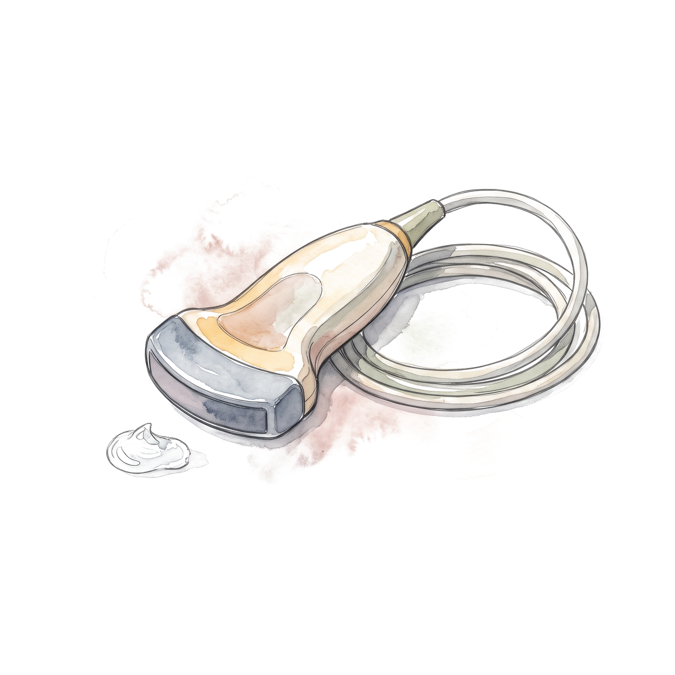
Who gets surveillance?
Ultrasound and AFP every 6 months?
Patient | Surveillance
Compensated cirrhosis, Child-Pugh A
Man from an endemic region, age 38, no cirrhosis
Man from an endemic region, age 46, no cirrhosis
Woman from an endemic region, age 46, no cirrhosis
Family history of HCC
PAGE-B score of 12
AASLD HCC practice guidance 2023, Table 1. Hepatology 2023;78:1922-1965, PMID 37199193.
34/57
Notes:
AASLD 2023 Table 1: noncirrhotic HBV: men over 40 and women over 50 from endemic regions; people of African origin earlier (the wording is origin-based, not an instruction to start every Black American at 20); family history of HCC; PAGE-B 10 or more (the table prints 'over 10' while the score's own intermediate group starts at 10). Ultrasound plus AFP every 6 months (level 2, strong). The thresholds behind these groups are about 0.2% a year for noncirrhotic HBV and 1.0% for cirrhosis. These are model-based decision thresholds, not biological cut-offs. Continue surveillance after HBsAg loss in cirrhosis, family history, men who lost HBsAg after 40 and women after 50 (AASLD/IDSA 2025 R6).

Slide 52
Who gets surveillance?
Ultrasound and AFP every 6 months?
Patient | Surveillance
Compensated cirrhosis, Child-Pugh A | Yes
Man from an endemic region, age 38, no cirrhosis | No
Man from an endemic region, age 46, no cirrhosis | Yes
Woman from an endemic region, age 46, no cirrhosis | No
Family history of HCC | Yes
PAGE-B score of 12 | Yes
AASLD HCC practice guidance 2023, Table 1. Hepatology 2023;78:1922-1965, PMID 37199193.
34/57
Notes:
AASLD 2023 Table 1: noncirrhotic HBV: men over 40 and women over 50 from endemic regions; people of African origin earlier (the wording is origin-based, not an instruction to start every Black American at 20); family history of HCC; PAGE-B 10 or more (the table prints 'over 10' while the score's own intermediate group starts at 10). Ultrasound plus AFP every 6 months (level 2, strong). The thresholds behind these groups are about 0.2% a year for noncirrhotic HBV and 1.0% for cirrhosis. These are model-based decision thresholds, not biological cut-offs. Continue surveillance after HBsAg loss in cirrhosis, family history, men who lost HBsAg after 40 and women after 50 (AASLD/IDSA 2025 R6).

Slide 53
Which HCC score for which patient
Score | Built in | Variables
PAGE-B | 1,815 treated White Europeans | Age, sex, platelets
mPAGE-B | 3,001 treated Asian patients | Age, sex, platelets, albumin
REACH-B | 3,584 untreated Taiwanese, noncirrhotic | Sex, age, ALT, HBeAg, DNA
aMAP | 17,374, mostly treated Asian HBV | Age, sex, albumin-bilirubin, platelets
REAL-B | 8,048 treated Asian patients | Sex, age, alcohol, diabetes, cirrhosis, platelets, AFP
Papatheodoridis 2016; Kim 2018; Yang 2011; Fan 2020; Yang 2020; Kim 2022 (dossier refs 38-42, 46).
35/57
Notes:
In 3,101 treated US veterans (39.5% White, 36.3% Black, 13.6% Asian; 113 HCC over 4.5 years) the 3-year AUC was 0.73 for PAGE-B and 0.57 for REACH-B; REAL-B and some AFP-containing models were above 0.80. REACH-B does poorly when moved from untreated noncirrhotic patients into treated ones, including those with cirrhosis. In HIV/HBV on tenofovir (2,963 patients), PAGE-B had a C-index of 0.77 and a negative predictive value of 99.4% below 10 at 5 years. Full formulas for mPAGE-B, aMAP and REAL-B were not confirmed, so do not reproduce their point tables.

Slide 54
Does qHBsAg refine HCC risk?
Tseng, Gastroenterology 2012 | Result
2,688 noncirrhotic Taiwanese, 191 HCC, mean 14.7 years | HBeAg-negative with DNA under 2,000: HBsAg 1,000 or more vs under 1,000 gave adjusted HR 13.7 (4.8 to 39.3)
Whole cohort | DNA was the stronger predictor; HBsAg alone did not add independently
Tseng TC et al. Gastroenterology 2012 (dossier ref 48).
36/57
Notes:
This replaces the flowchart you sent: it had a Gemini watermark and no source. What the literature supports: a high HBsAg in an HBeAg-negative patient with low DNA predicts HCC, and the best studied cut-off is 1,000 IU/mL. Not supported: that qHBsAg adds nothing in F3 to F4, a universal cut-off of 100, and any reading of qHBsAg as an integration-burden meter. The Tseng 2013 Hepatology paper is about hepatitis events (HR 1.5), and the 13.2 hazard ratio in the 2012 Hepatology paper is for HBsAg loss, not HCC.

Slide 55
Integration of HBV DNA
Study | Finding
Mason 2016, 26 patients aged 14 to 39 | Integration and clonal hepatocyte expansion found in immune-tolerant patients as well, before ALT rises
Grudda 2022, 16 HIV/HBV patients | Integrated DNA keeps producing HBsAg despite antiviral therapy
Mason WS et al. Gastroenterology 2016 (dossier ref 50); Grudda T et al. 2022 (ref 51).
37/57
Notes:
Biology, not an outcome trial. It explains why HBsAg can persist when DNA is undetectable and why 'immune tolerant' is not a safe phase. It does not show that early treatment prevents HCC. Small tissue studies; abstract only.

Slide 56
Risk of HBV reactivation
How risky is each drug if HBsAg is negative and anti-HBc is positive?
Drug | Reactivation risk
Rituximab or other anti-CD20
Anthracyclines
JAK inhibitors
Prednisone 20 mg or more for 4 weeks or longer
Anti-TNF
Immune checkpoint inhibitors
Methotrexate, azathioprine
AGA guideline 2025, Table 6. Gastroenterology 2025;168:267-284, PMID 39863345. High above 10%, moderate 1 to 10%, low below 1%.
38/57
Notes:
Our patient from earlier: anti-HBc positive, HBsAg negative, starting rituximab. AGA risk categories: high above 10%, moderate 1 to 10%, low below 1%. The risk depends on the drug and on serostatus: for HBsAg-positive patients, most of these drugs are high risk (anti-TNF, anthracyclines, JAK inhibitors). EASL 2025 Table 14 differs on several assignments (for example anti-TNF moderate and anthracyclines high in resolved infection), so do not mix the tables. There is no separate current ASH guideline; do not cite one.

Slide 57
Risk of HBV reactivation
How risky is each drug if HBsAg is negative and anti-HBc is positive?
Drug | Reactivation risk
Rituximab or other anti-CD20 | High
Anthracyclines | Moderate
JAK inhibitors | Moderate
Prednisone 20 mg or more for 4 weeks or longer | Moderate
Anti-TNF | Low
Immune checkpoint inhibitors | Low
Methotrexate, azathioprine | Low
AGA guideline 2025, Table 6. Gastroenterology 2025;168:267-284, PMID 39863345. High above 10%, moderate 1 to 10%, low below 1%.
38/57
Notes:
Our patient from earlier: anti-HBc positive, HBsAg negative, starting rituximab. AGA risk categories: high above 10%, moderate 1 to 10%, low below 1%. The risk depends on the drug and on serostatus: for HBsAg-positive patients, most of these drugs are high risk (anti-TNF, anthracyclines, JAK inhibitors). EASL 2025 Table 14 differs on several assignments (for example anti-TNF moderate and anthracyclines high in resolved infection), so do not mix the tables. There is no separate current ASH guideline; do not cite one.

Slide 58
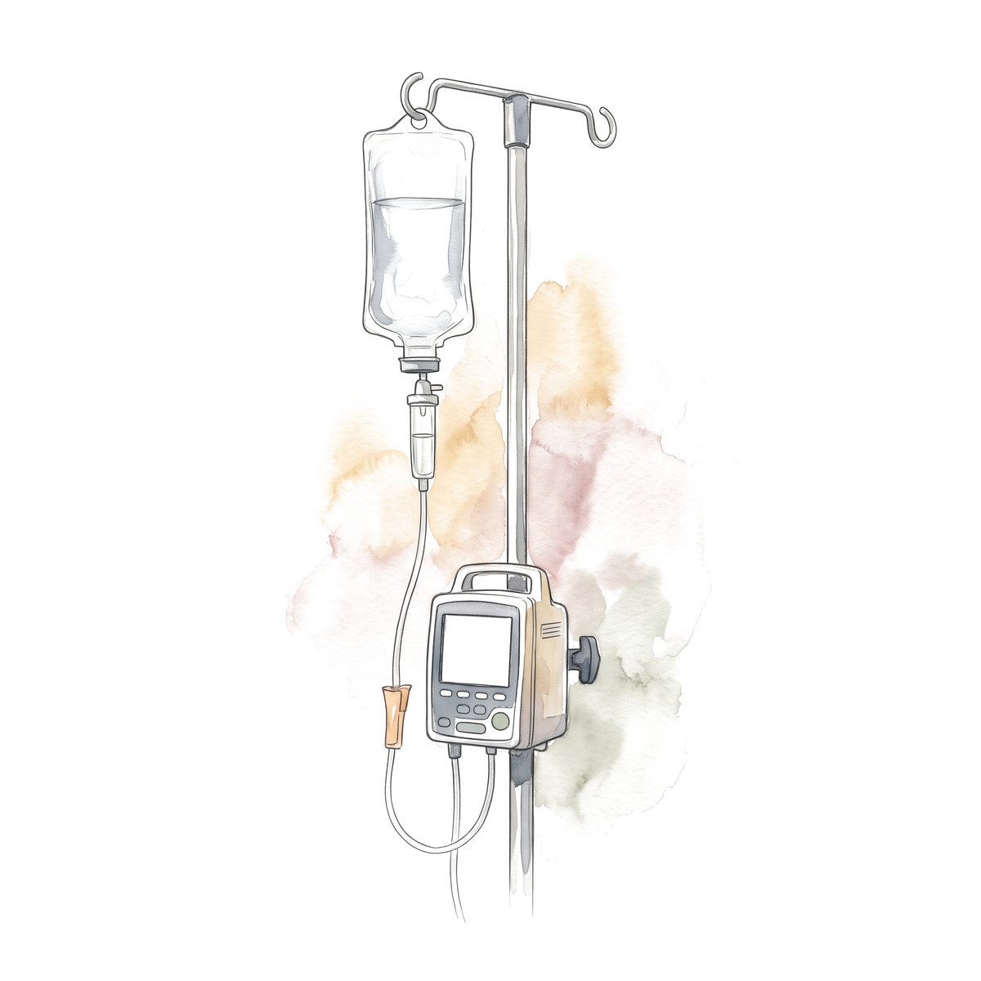
Rituximab, six cycles
What do you give, and for how long?
Rituximab
Entecavir, TDF or TAF
Start
Month 6
Month 12
Month 18
AGA 2025 (PMID 39863345); AASLD 2018 (PMID 29405329); EASL 2025 (PMID 40348683).
39/57
Notes:
High-risk exposure with anti-HBc positive: prophylaxis rather than monitoring (AGA R1, strong). Use a high-barrier drug: entecavir, TDF or TAF. Continue at least 6 months after the immunosuppression ends and at least 12 months for B-cell-depleting therapy (AGA and AASLD 2018); EASL 2025 says 6 to 12 months and at least 18 months after B-cell depletion. For a moderate-risk exposure in a DNA-negative resolved infection, AGA favors prophylaxis but accepts monitoring. ACR 2021 and ASCO 2020 give the rheumatology and oncology versions.

Slide 59
Rituximab, six cycles
What do you give, and for how long?
Rituximab
Entecavir, TDF or TAF
Continue 12 months after the last dose
Start
Month 6
Month 12
Month 18
Start before the first dose. If you only monitor: DNA and ALT every 1 to 3 months
AGA 2025 (PMID 39863345); AASLD 2018 (PMID 29405329); EASL 2025 (PMID 40348683).
39/57
Notes:
High-risk exposure with anti-HBc positive: prophylaxis rather than monitoring (AGA R1, strong). Use a high-barrier drug: entecavir, TDF or TAF. Continue at least 6 months after the immunosuppression ends and at least 12 months for B-cell-depleting therapy (AGA and AASLD 2018); EASL 2025 says 6 to 12 months and at least 18 months after B-cell depletion. For a moderate-risk exposure in a DNA-negative resolved infection, AGA favors prophylaxis but accepts monitoring. ACR 2021 and ASCO 2020 give the rheumatology and oncology versions.

Slide 60
Prophylaxis: the guidelines compared
 | AGA 2025 | AASLD 2018 | EASL 2025 | ASCO 2020
Anti-CD20, anti-HBc positive | Prophylaxis | Prophylaxis | Prophylaxis | Prophylaxis
Drug | High barrier | ETV, TDF or TAF | ETV, TDF or TAF | High barrier
After the last dose | 6 months, 12 for B-cell depletion | 6 months, 12 for anti-CD20 | 6 to 12 months, 18 for B-cell depletion | 12 months
If monitoring | DNA, ALT every 1 to 3 months | DNA every 1 to 3 months | Every 3 months | By regimen
AGA PMID 39863345; AASLD PMID 29405329; EASL PMID 40348683; ASCO 2020 PMID 32716741; ACR 2021 PMID 34101387.
40/57
Notes:
From the reviewer's comparison (dossier A5). ACR 2021 (rheumatoid arthritis): strong recommendation for prophylaxis in anti-HBc-positive patients starting rituximab regardless of HBsAg, and in HBsAg-positive patients starting any biologic or targeted synthetic DMARD; monitoring is conditionally preferred for HBsAg-negative anti-HBc-positive patients on other agents.

Slide 61
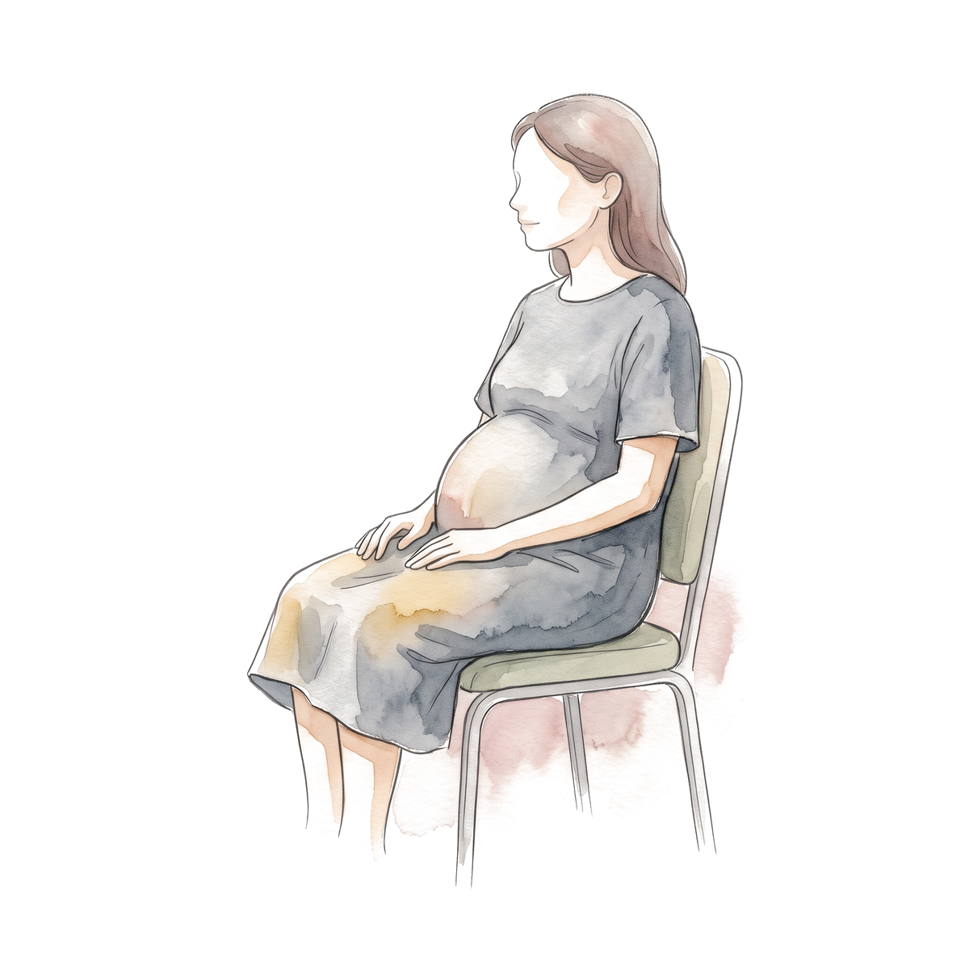
29-year-old woman, 20 weeks pregnant
HBsAg | HBeAg | HBV DNA | ALT
Positive | Positive | 5,000,000 IU/mL | 22 U/L
What do you do for her and for the baby?
41/57
Notes:
Born in Ethiopia, HBeAg positive, all values made up. AASLD/IDSA 2025 R1 (strong, moderate certainty): DNA above 200,000 at any point, start TDF or TAF at week 28 (consider week 16 when infant HBIG is not available). WHO 2024 also treats HBeAg-positive mothers regardless of DNA. Mother's ALT is normal, so this is prophylaxis to prevent transmission; stopping at delivery is allowed when treatment was only for that purpose, with DNA and ALT every 1 to 3 months for 6 months. Infant: single-antigen hepatitis B vaccine plus HBIG within 12 hours at separate sites, then complete the series. Breastfeeding is not prohibited.

Slide 62
29-year-old woman, 20 weeks pregnant
HBsAg | HBeAg | HBV DNA | ALT
Positive | Positive | 5,000,000 IU/mL | 22 U/L
What do you do for her and for the baby?
TDF or TAF from week 28, because DNA is above 200,000 IU/mL
Baby: hepatitis B vaccine and HBIG within 12 hours of birth
41/57
Notes:
Born in Ethiopia, HBeAg positive, all values made up. AASLD/IDSA 2025 R1 (strong, moderate certainty): DNA above 200,000 at any point, start TDF or TAF at week 28 (consider week 16 when infant HBIG is not available). WHO 2024 also treats HBeAg-positive mothers regardless of DNA. Mother's ALT is normal, so this is prophylaxis to prevent transmission; stopping at delivery is allowed when treatment was only for that purpose, with DNA and ALT every 1 to 3 months for 6 months. Infant: single-antigen hepatitis B vaccine plus HBIG within 12 hours at separate sites, then complete the series. Breastfeeding is not prohibited.

Slide 63
Her pregnancy and the baby's first year
Mother: TDF or TAF
Stop at delivery is allowed
Mother: DNA and ALT
Every 1 to 3 months
Baby: vaccine and HBIG
Within 12 hours
Baby: HBsAg and anti-HBs
Month 9 to 12
Week 20
Week 28
Delivery
Month 6
Month 12
AASLD/IDSA 2025 R1 (PMID 41186418); CDC perinatal hepatitis B overview, 2025.
42/57
Notes:
Timeline from the AASLD/IDSA 2025 recommendation and the CDC infant schedule. Infant testing is HBsAg and anti-HBs at 9 to 12 months, or 1 to 2 months after a delayed final dose. Do not use anti-HBc for infant testing after vaccination. Evidence: Pan, NEJM 2016 (200 HBeAg-positive mothers; transmission 5% vs 18% by intention to treat) and Jourdain, NEJM 2018 (331 women; 0 vs 3 infected infants, p = 0.12, not superior because infant prophylaxis was already excellent).

Slide 64
Tenofovir in pregnancy: the trials
Jourdain 2018 | TDF | Placebo
Infected infants | 0 of 147 | 3 of 147
p | 0.12
Infant HBIG and vaccine were given about an hour after birth in Thailand
Pan CQ et al. NEJM 2016 (PMID in dossier ref 52). Jourdain G et al. NEJM 2018 (ref 53).
43/57
Notes:
Pan: 200 HBeAg-positive mothers with DNA above 200,000, TDF from week 30 to 32 to 4 weeks postpartum versus usual care: infant infection 5/97 (5%) vs 18/100 (18%) by intention to treat, 0 vs 6/88 (7%) per protocol. Post-withdrawal ALT elevations in mothers 45% vs 30%. Jourdain: 331 women, TDF from week 28 to 2 months postpartum: infant infection 0/147 vs 3/147 (2%), p = 0.12. A 2025 randomized trial (Pan, JAMA) starting TDF at week 16 without HBIG was noninferior to week 28 plus HBIG: 1/131 vs 0/142.

Slide 65
Coinfection with HIV or HCV
Coinfection | What to do
HIV | ART must include TDF or TAF plus emtricitabine or lamivudine. Entecavir alone is not HIV treatment
HCV, HBsAg positive | DNA every 4 to 8 weeks during direct-acting antivirals and for 3 months after
HCV, HBsAg negative and anti-HBc positive | Much lower risk. Check DNA and HBsAg if the ALT rises unexpectedly
AASLD 2018, PMID 29405329.
44/57
Notes:
AASLD 2018 guidance statements (ungraded). Current HIV guidance and drug interactions still need review before choosing the ART regimen.

Slide 66
Hepatitis D: who to test
 | AASLD 2018 | EASL 2025
Who | Risk-based: endemic origin, HIV, injection drug use, high ALT with low DNA | Every HBsAg-positive patient, at least once
How | Total anti-HDV, then HDV RNA if positive | Total anti-HDV, then HDV RNA
AASLD 2018, PMID 29405329; EASL 2025, PMID 40348683.
45/57
Notes:
Total anti-HDV for exposure, HDV RNA for current infection. A nucleos(t)ide analogue suppresses HBV but does not treat HDV. In the core version, give this one line only: test every HBsAg-positive patient once.

Slide 67
Bulevirtide for hepatitis D
FDA accelerated approval 22 May 2026
8.5 mg subcutaneously, once a day
Adults without cirrhosis or with compensated cirrhosis
Boxed warning: stopping can cause severe exacerbations
FDA news release 22 May 2026. MYR301, week 48. Combined response: HDV RNA undetectable or 2 log decline, and normal ALT.
46/57
Notes:
MYR301 as described by FDA: immediate treatment with 8.5 mg once daily for 144 weeks versus delayed treatment (48 weeks observation, then treatment). Week 48 combined response 48% vs 2%; undetectable HDV RNA 20% vs 0%; at weeks 96 and 144 undetectable RNA 36% and 50%. Accelerated approval rests on this surrogate response; clinical benefit needs confirmation. Side effects: hypersensitivity, injection site reactions, headache, abdominal pain, fatigue, itching. The dossier's published MYR301 numbers (2 mg 45%, 10 mg 48%) are from the NEJM paper; the slide uses FDA's numbers for the approved dose. Gilead is the sponsor.

Slide 68
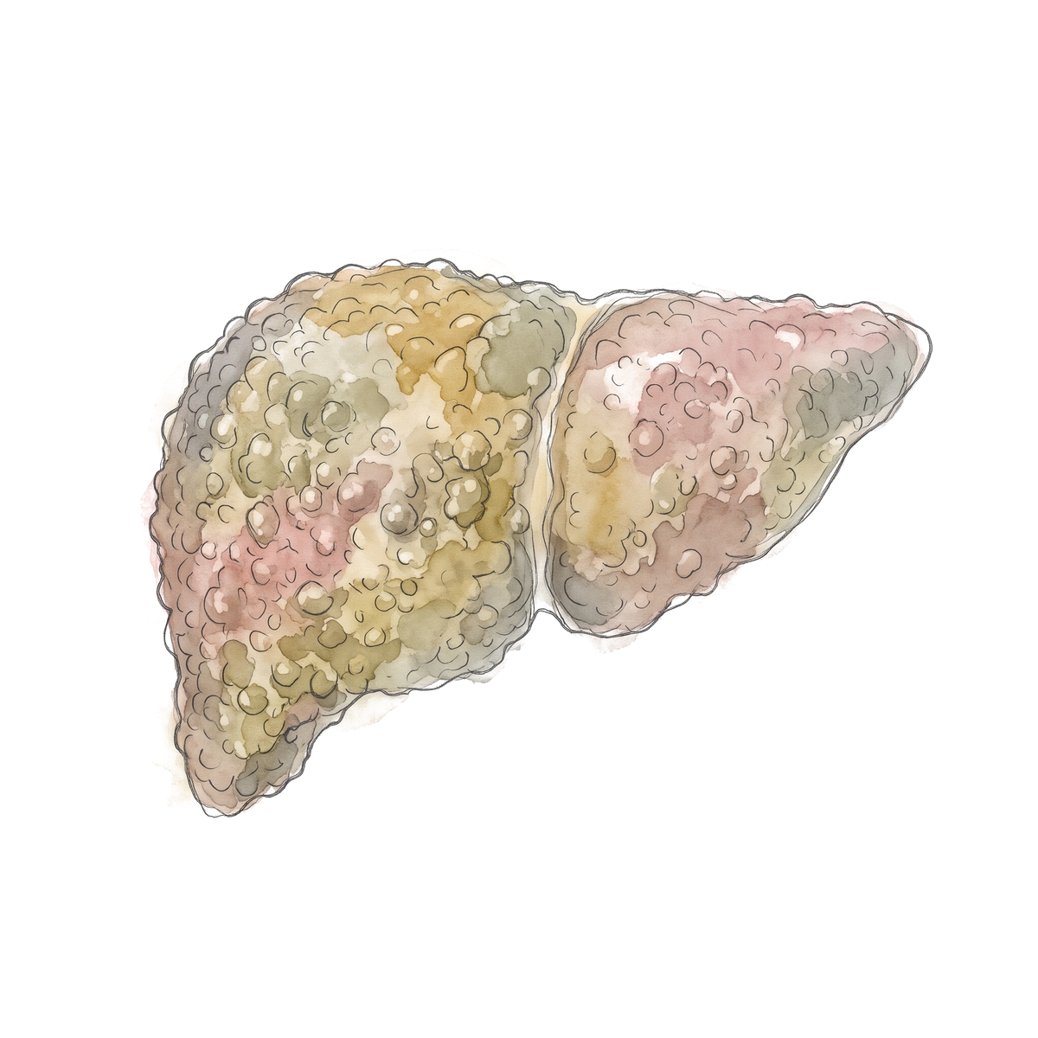
Cirrhosis and decompensation
Jang, observational | Treated | Untreated
First decompensation, n = 707 | 423 | 284
5-year transplant-free survival | 59.7% | 46.0%
Delisted on treatment | 33.9%
Jang JW et al. 2015 (dossier ref 56).
47/57
Notes:
Not randomized, and the antivirals were those of that era. Do not promise one-third delisting to every patient today. AASLD 2018 R7B: treat decompensated disease indefinitely regardless of DNA, ALT or HBeAg, and assess for transplant. PegIFN is contraindicated. The US TAF label does not recommend Child-Pugh B or C. Call transplant hepatology.

Slide 69
HBV and liver transplant
Anti-HBc positive donor, HBV-naive recipient (Cholongitas, older regimens)
Entecavir alone without HBIG: 265 recipients, 92% HBsAg negative and 100% DNA undetectable at 8 years (Fung)
Long-term nucleos(t)ide analogue for HBsAg-negative recipients of anti-HBc-positive grafts
Cholongitas E et al. 2010 (dossier ref 59). Fung J et al. 2017 (ref 57). AASLD 2018 section 6H.
48/57
Notes:
Cholongitas: 39 studies, 903 recipients, regimens of that time, so the rates are not contemporary entecavir or tenofovir rates. AASLD 2018 supports indefinite high-barrier NA after transplant for HBV; selected low-risk patients may get no HBIG or 5 to 7 days plus NA, higher-risk patients (HIV, HDV, adherence concerns) HBIG plus NA. HBIG alone is not appropriate. The AST 2019 wording was not opened, so quote AASLD 2018 here. Fung 2017: nine-year survival 85%, no fatal HBV recurrence reported.

Slide 70
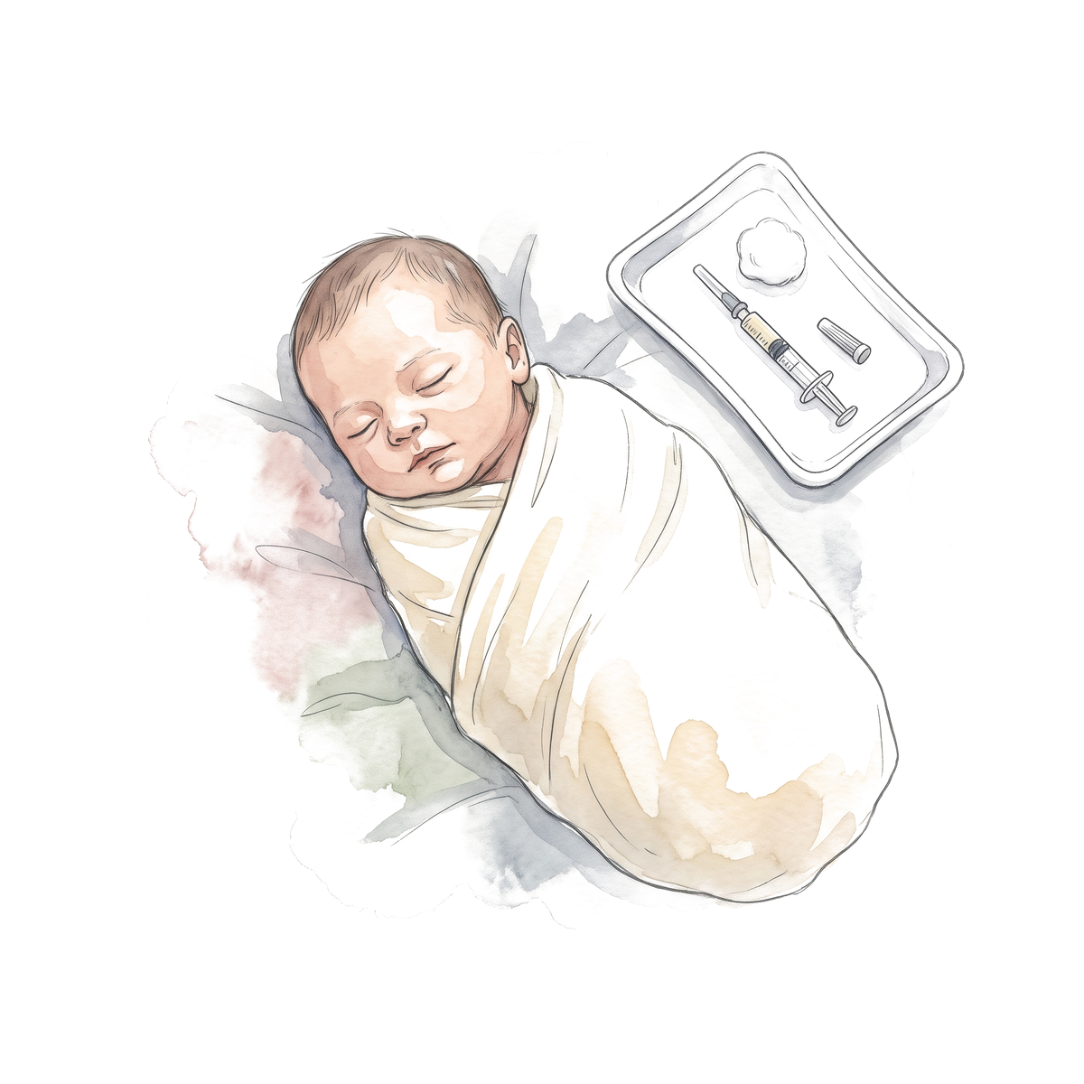
Children and adolescents
 | Who is treated
AASLD 2018 | HBeAg-positive, age 2 to under 18, raised ALT and measurable DNA. Normal ALT: no routine treatment
WHO 2024 | Adolescents 12 and older use the adult pathways. Younger children are individualized
US labels | Entecavir and TDF from age 2. TAF from age 6 and 25 kg
AASLD 2018 R9A and R9B; WHO 2024 chapter 8; DailyMed labels.
49/57
Notes:
Label ages are approval ages, not indications to treat. WHO's noninvasive fibrosis cut-offs are not validated in children and adolescents.

Slide 71
Same man, 57 years old, five years on TAF
Condition for stopping | Our patient | Met?
No cirrhosis or advanced disease | Stiffness 5.9 kPa
HBV DNA undetectable for 2 years or more | Undetectable for 5 years
HBsAg under 100 IU/mL | 400 IU/mL
No HIV or HDV | Both negative
Reliable follow-up | Yes
Can he stop?
AASLD/IDSA 2025 R5. Hepatology 2026;83:974-997, PMID 41186418.
50/57
Notes:
HBeAg negative, started on TAF at 52. AASLD/IDSA 2025 R5 (conditional, very low certainty) suggests continuing until HBsAg loss; stopping only in exceptions: no advanced complications, DNA undetectable at least 2 years, qHBsAg under 100, no HIV or HDV, reliable follow-up. If HBeAg-positive at the start, seroconverted at least 1 year. The text says 2 years and the guideline's Figure 4 legend says 3, so quote 2 to 3. If you do stop: DNA and ALT every 1 to 3 months for 6 months, then every 3 months for 6 to 12 months, then every 3 to 6 months. Retreat for DNA 10,000 or more, ALT above 5 times ULN, bilirubin above 2.5 or decompensation (Table 3). Evidence in the extended version. Values are made up.

Slide 72
Same man, 57 years old, five years on TAF
Condition for stopping | Our patient | Met?
No cirrhosis or advanced disease | Stiffness 5.9 kPa | Yes
HBV DNA undetectable for 2 years or more | Undetectable for 5 years | Yes
HBsAg under 100 IU/mL | 400 IU/mL | No
No HIV or HDV | Both negative | Yes
Reliable follow-up | Yes | Yes
Can he stop?
No. Continue until HBsAg is lost
AASLD/IDSA 2025 R5. Hepatology 2026;83:974-997, PMID 41186418.
50/57
Notes:
HBeAg negative, started on TAF at 52. AASLD/IDSA 2025 R5 (conditional, very low certainty) suggests continuing until HBsAg loss; stopping only in exceptions: no advanced complications, DNA undetectable at least 2 years, qHBsAg under 100, no HIV or HDV, reliable follow-up. If HBeAg-positive at the start, seroconverted at least 1 year. The text says 2 years and the guideline's Figure 4 legend says 3, so quote 2 to 3. If you do stop: DNA and ALT every 1 to 3 months for 6 months, then every 3 months for 6 to 12 months, then every 3 to 6 months. Retreat for DNA 10,000 or more, ALT above 5 times ULN, bilirubin above 2.5 or decompensation (Table 3). Evidence in the extended version. Values are made up.

Slide 73
What happens when you stop
Study | Patients | HBsAg loss | Retreatment
STOP-NUC, randomized (Van Bommel 2023) | 166 | 10.1% vs 0% at 96 weeks | 13.9%
RETRACT-B, cohort (Hirode 2022) | 1,552 | 3.2% at 12 months, 13.0% at 48 months | See paper
FINITE, randomized (Berg 2017) | 42 | 4 of 21 (19%) in the stop arm at 144 weeks | 13 of 21 stayed off therapy
Van Bommel F et al. J Hepatol 2023 (dossier ref 61); Hirode G et al. Gastroenterology 2022 (ref 60); Berg T et al. J Hepatol 2017 (ref 62).
51/57
Notes:
RETRACT-B: end-of-treatment HBsAg under 100 predicted loss (subdistribution HR 22.5, 13.1 to 38.7); loss was much more likely in White than Asian patients (HR 6.8). STOP-NUC: 79 per arm, DNA undetectable at least 4 years; in those with HBsAg under 1,000, loss was 7 of 25 (28%). Loss, relapse, retreatment and sustained remission are different endpoints and cannot be subtracted from each other. Severe flares can happen: a case of HBV-induced liver failure requiring emergency transplant after a finite-treatment strategy (REEF-2 report).

Slide 74
Definitions of cure
Endpoint | Definition
Functional cure | HBsAg loss and HBV DNA below quantification, 24 weeks off therapy
Partial cure | HBsAg under 100 IU/mL and DNA below quantification, 24 weeks off therapy
Sterilizing cure | Elimination of the viral templates (cccDNA and integrated DNA)
Ghany MG et al. 2023 (dossier ref 65).
52/57
Notes:
From the 2022 AASLD/EASL endpoint conference report (published 2023). Standard nucleos(t)ide therapy rarely gives HBsAg loss. Functional cure does not show that cccDNA or integrated DNA are gone.

Slide 75
Approved in 2026
 | Bepirovirsen (Hibsago) | Bulevirtide (Hepcludex)
For | Chronic hepatitis B | Chronic hepatitis D
FDA approval | 20 October 2026 | 22 May 2026
Who | Adults without cirrhosis, on a nucleos(t)ide analogue 6 months or more, DNA suppressed, HBsAg 3,000 IU/mL or lower | Adults without cirrhosis or with compensated cirrhosis
Result | 19% had HBsAg undetectable 24 weeks after stopping all treatment; 0% on placebo | Week 48: combined response 48% vs 2%
Warning | Liver reactions, low platelets | Severe exacerbation if stopped
FDA news releases 20 October 2026 (bepirovirsen) and 22 May 2026 (bulevirtide). B-Well 1 and 2, Hou, NEJM 2026.
53/57
Notes:
From the FDA pages. Bepirovirsen is an antisense oligonucleotide given under the skin for up to 24 weeks, together with the existing antiviral, which continues for at least 24 weeks after the last injection; some patients can then stop it. Across the two trials 24% met the criteria to stop their existing medicine versus none on placebo, and 19% still had suppressed virus with undetectable HBsAg 24 weeks after stopping all hepatitis B treatment. The FDA also authorized a Roche qHBsAg assay as a companion diagnostic. Boxed warning for serious liver reactions and low platelets; warnings include worsening kidney function and vasculitis. Hepcludex: accelerated approval, boxed warning for severe exacerbations of HDV and HBV on discontinuation.

Slide 76
Bepirovirsen: B-Well 1 and 2
Functional cure at week 72: HBsAg loss and DNA below quantification at least 24 weeks off all therapy
127 of 650 vs 0 of 328, and 106 of 570 vs 0 of 286
Noncirrhotic, stable NA, HBsAg 100 to 3,000 IU/mL
Grade 3 or higher adverse events 16% vs 3%
Hou J et al. N Engl J Med 2026 (B-Well 1 and 2, dossier ref 67). Final issue 25 June 2026.
54/57
Notes:
The sponsor's phase 3 trials: 978 and 856 participants. The FDA pooled figure is 19%. The earlier phase 2b B-Clear (Yuen, NEJM 2022, 457 participants): 300 mg for 24 weeks gave sustained response in 9% on NA and 10% off NA. Eligibility is narrow (noncirrhotic, suppressed, low HBsAg), so this is not a cure rate for all patients with hepatitis B.

Slide 77
In the pipeline
Agent | Phase 2 result | Caution
Xalnesiran (siRNA) | HBsAg loss at 24 weeks after treatment 7% (100 mg), 3% (200 mg), 12% with ruzotolimod, 23% with PegIFN, 0% NA alone | Background NA continued
Elebsiran with PegIFN | HBsAg loss 21% (200 mg) and 33% (100 mg) vs 6% with PegIFN alone | NA stopping follow-up ongoing
JNJ-3989 (siRNA) | Met NA-stopping criteria at week 48 in 5, 16 and 19% (40, 100, 200 mg) vs 2% | Stopping eligibility, not cure
Imdusiran (siRNA) | Phase 1a/b, safety primary | No cure rate yet
Dossier refs 66 to 71 and registry entries NCT04225715 and NCT06245291.
55/57
Notes:
The endpoints matter: HBsAg decline on NA, HBsAg loss with NA continuing, and sustained functional cure off all therapy are not the same. Xalnesiran (Hou 2024 NEJM, 159 participants; all HBsAg loss was at baseline HBsAg under 1,000). Elebsiran (ENSURE, Wong, Nat Med 2026): part 1 N = 55. JNJ-3989 REEF-1 (Yuen 2023, 470 randomized). Imdusiran (Yuen 2026). Check each paper before quoting; most are abstract-level in the dossier. Checkpoint inhibitor trials: an imdusiran plus durvalumab registry entry was withdrawn with no enrollment, which says nothing about the class.

Slide 78
Back to our patients
 | Patient | Decision
1 | Man, 34 to 57. HBeAg-positive, then HBeAg-negative with DNA 8,000 and ALT 48 | Monitor at 34. Treat at 41 (age) or at 52 (grey zone). PAGE-B 18, surveillance. Do not stop with HBsAg 400
2 | Woman, 61. Anti-HBc positive, HBsAg negative, rituximab | Entecavir, TDF or TAF before the first dose and for 12 months after the last
3 | Woman, 29, 20 weeks pregnant. DNA 5,000,000 | TDF or TAF from week 28. Vaccine and HBIG within 12 hours. Test the baby at 9 to 12 months
56/57
Notes:
Close the loop on the three patients. Then take questions.

Slide 79
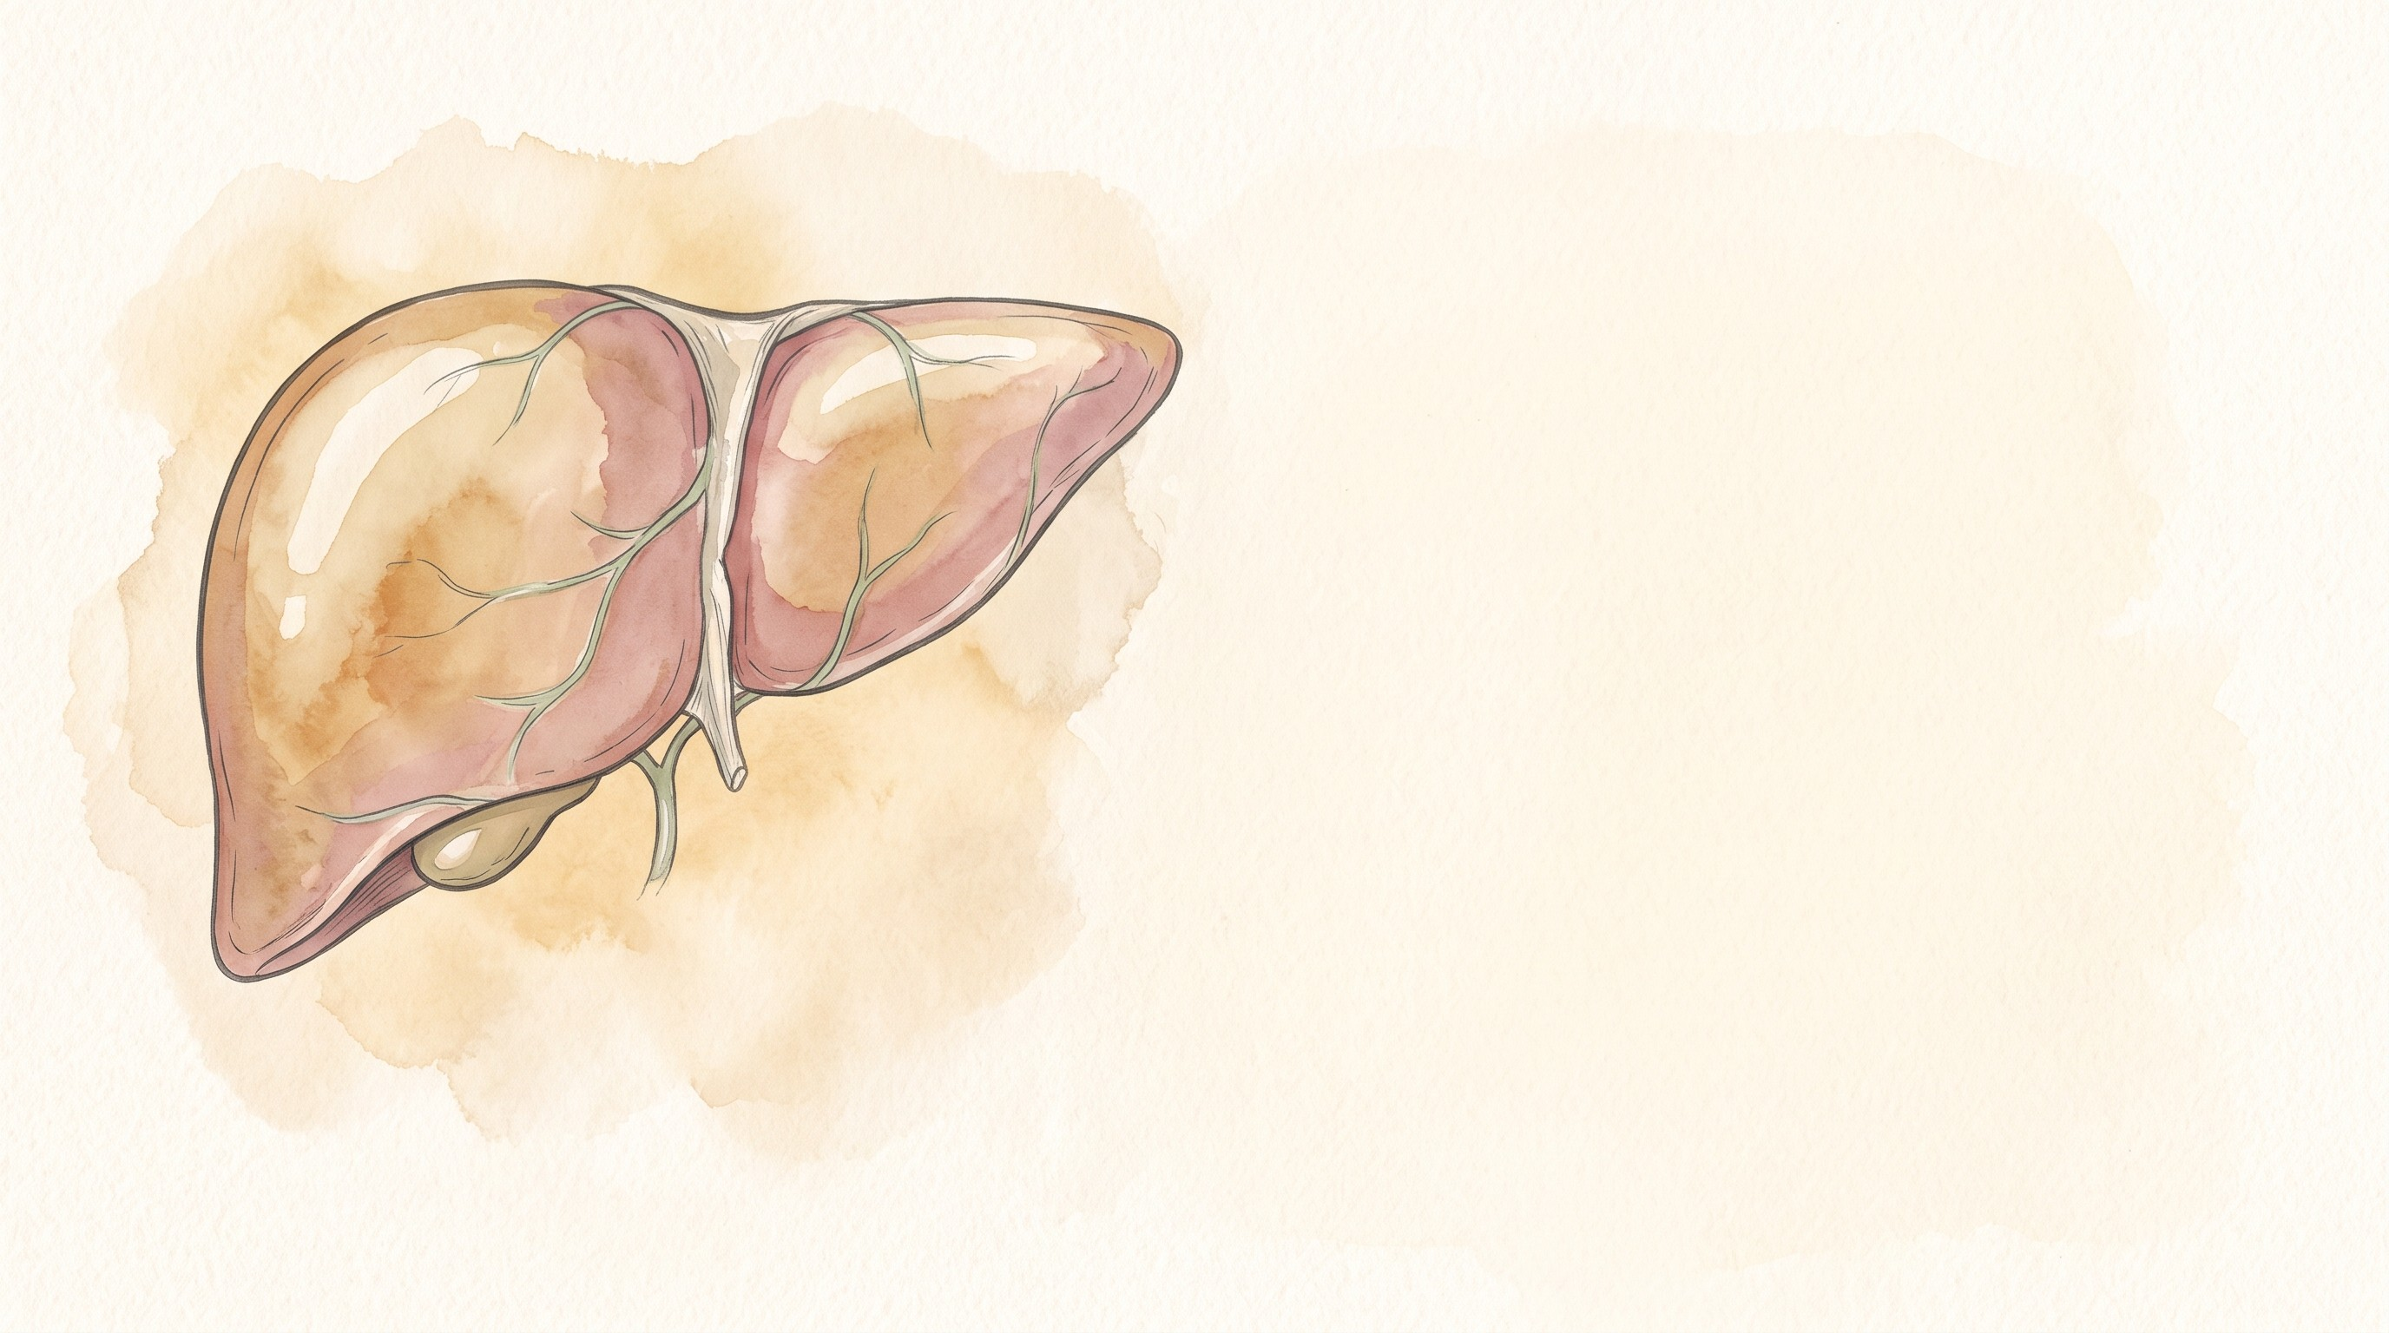
Questions?
X: @mfalmeqdadi
Slides (PDF)
57/57
Notes:
The QR code opens the slides PDF. The HBV HCC risk calculator is at qaddodi.github.io/chb-hcc-risk.

